Slide 1

Dead or alive : towards a sustainable wildlife trade
Bushmeat trade
Customs controls on illegal importation of meat
Brussels
3-4 december 2019
Vera Jansegers
General Administration Customs and Excise

Slide 2
Mission

Slide 3




Mission
Secure
Protect
Finance
Facilitate
the European Union and Belgium from unfair and illegal trade while supporting legitimate business activity
the European Union and its residents and protect the environment, where appropriate in close cooperation with other authorities
the European Union and Belgium, by collecting excise duty, customs duty and VAT (on imports)
legitimate trade, whilst maintaining a proper balance with customs and excise controls

Slide 4

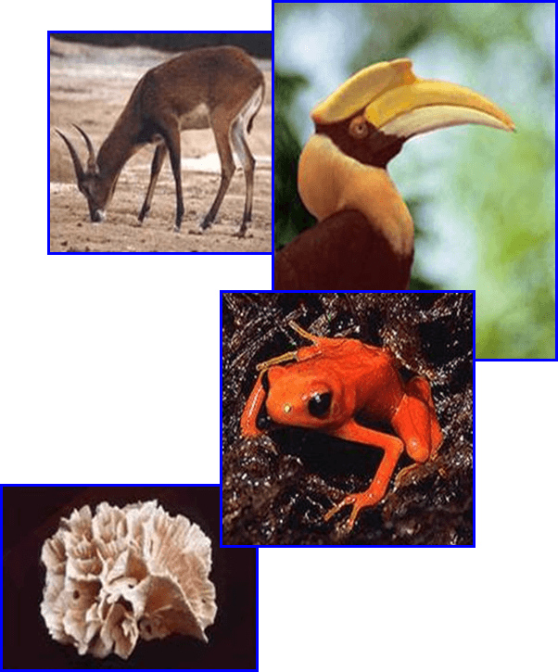
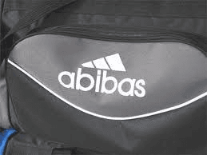

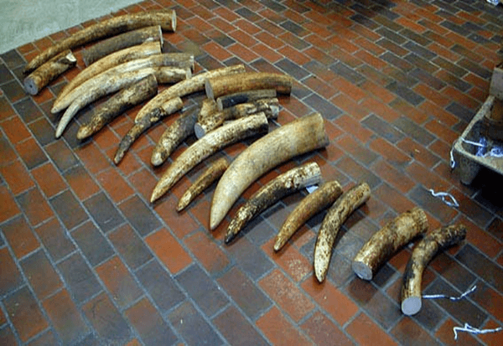
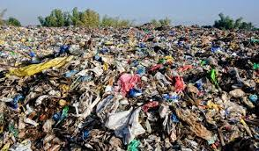
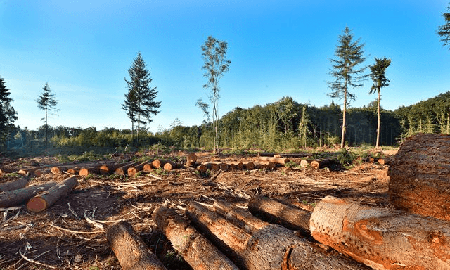
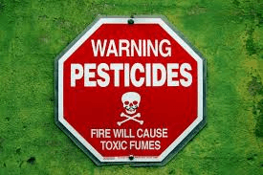

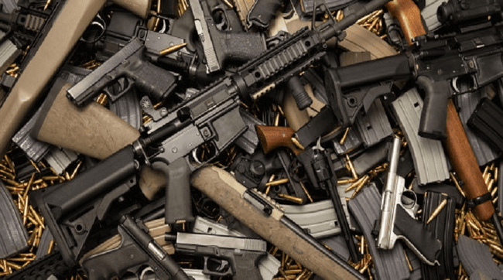
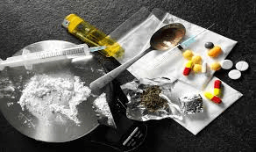
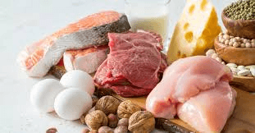
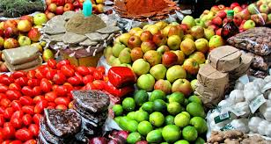
Customs working areas

Slide 5
Customs control procedures

Slide 6
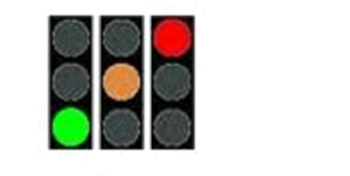
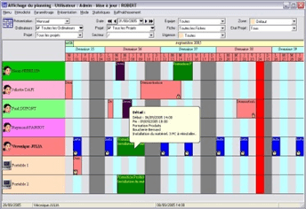
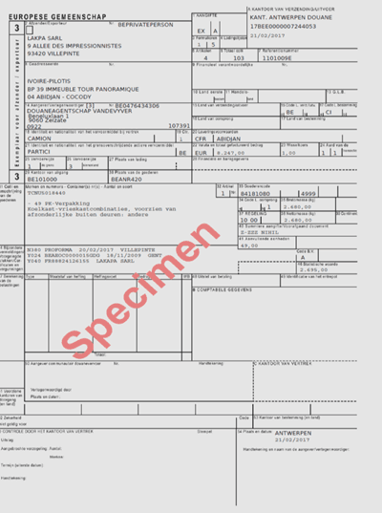
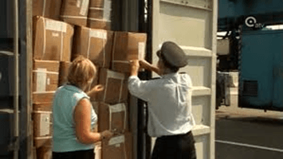
Selection
Planification
Documentary check
Physical inspection of goods
Customs control procedures

Slide 7

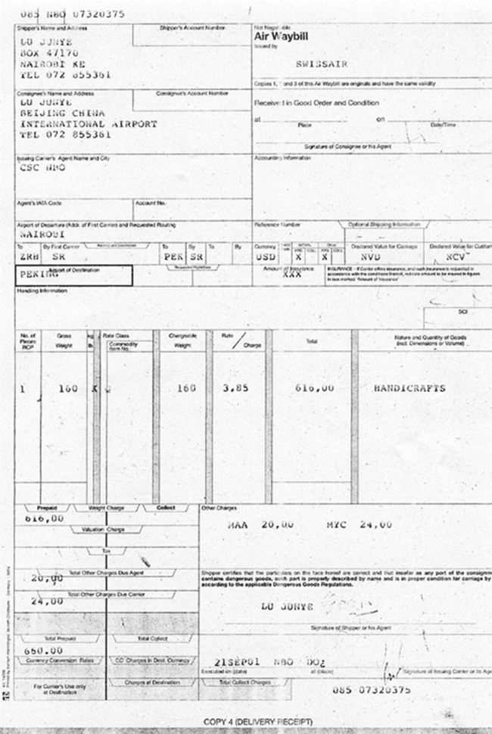
Check validity and conformity
- Customs declaration
- CVED / CITES license (endangered species)
- commercial documents
Documentary checks

Slide 8
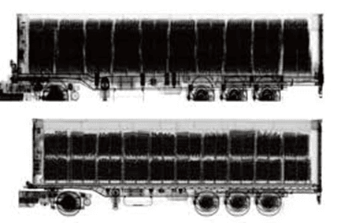
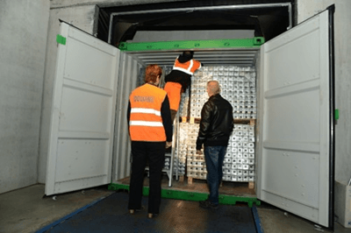
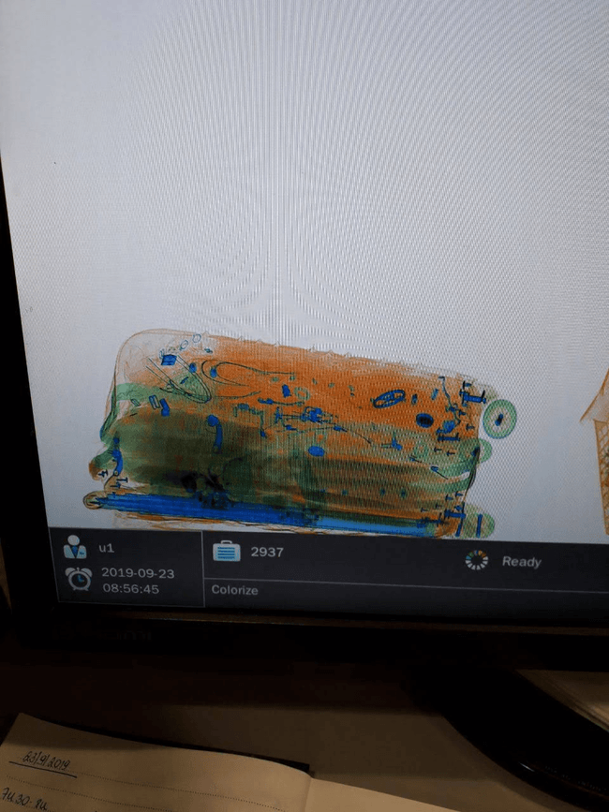
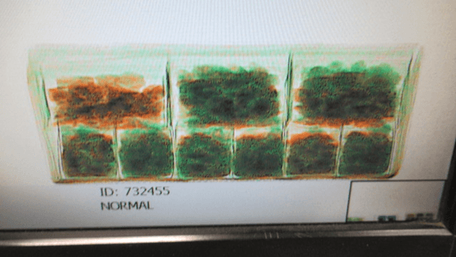
Scan / Physical checks

Slide 9


In case of conformity : customs can release the consignment
In case of non-conformity : customs STOP the consignment and INFORM the competent authority
Role of customs
National competent authority takes final decision on consignment

Slide 10
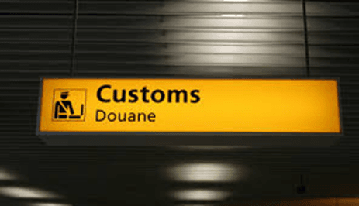
- Customs controls at travelers’ point of entry at the airports of Zaventem, Oostende, Deurne,
Liège and Charleroi
- on daily basis
- ad random
- risk based selection of flights
Customs controls on personal consignments

Slide 11
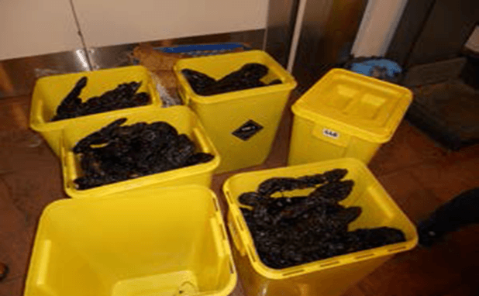
In accordance to Regulation 206/2009 : not allowed to bring in meat (products), milk (products) and other products of animal origin (except within limited quantities) for personal use via travelers’ luggage :
- customs seize the prohibited meat and other products from the travelers’ luggage
- customs let travelers sign a document of voluntary surrender of goods
- abandoned goods are placed in boxes for destruction
Customs controls on personal consignments

Slide 12
- seized meat is difficult to determine on sight if bushmeat or not.
If no further analysis is done, there is no certainty about the kind of the species all meat is seized and destroyed regardless of the species
Customs controls on personal consignments

Slide 13
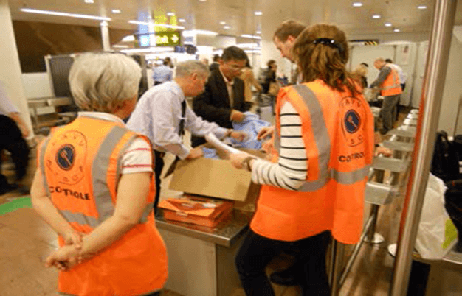
- Reinforced controls : joint actions on travelers’ luggage
BACON (BAgage CONtrols)
- In cooperation with national competent authorities for food safety, CITES, medicines and cosmetics
- Opportunities:
-exchanging expertise on the spot
-strengthening cooperation
-enhancing the joint controls in airports
-improving risk analysis
Customs joint controls on personal consignments

Slide 14
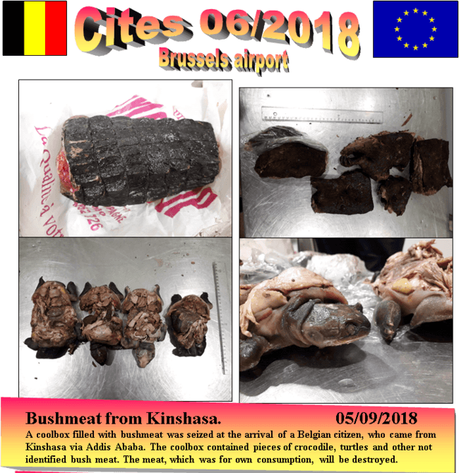
Customs controls on personal consignments
Newsletters - important information - will be shared with customs officers and other competent authorities

Slide 15
-
Seizures – personal consignments

Slide 16
Thank You for your attention

