Slide 1
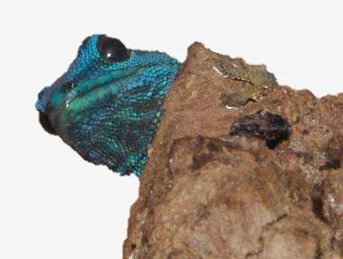


Challenges for a legal, sustainable and traceable trade in live amphibians and reptiles into the EU
Dr. Mark Auliya
Conference:
Dead or Alive: Towards a Sustainable Wildlife Trade - One World One Health
4 December 2019, Brussels
[ 12:30-12:50 ]
All photos by M. AULIYA, otherwise indicated

Slide 2
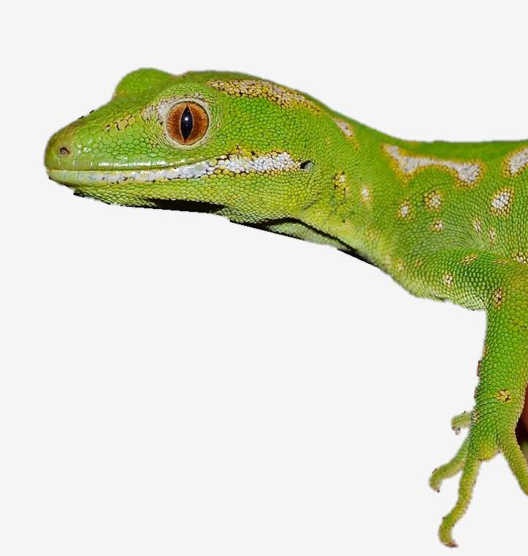
Outline
Facts (issues, challenges) underlying the subject
Amphibians & reptiles listed on CITES and EU Wildlife Trade Regulations
IUCN Red listed amphibians & reptiles
Triggers & criteria of most-wanted species
Scientific uncertainties prevail in legally traded species
Mortalities
Origin/source reporting issues
Diseases
Illegal trade
Summarizing issues/challenges
Recommendations
Naultinus grayi, house search, Germany

Slide 3
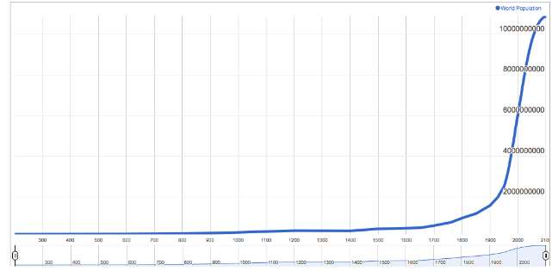
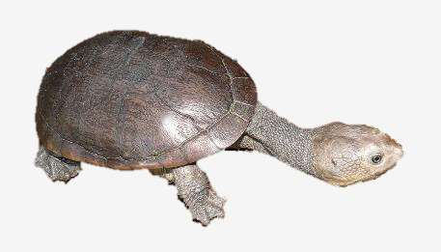
(1) Facts (issues, challenges) underlying the subject
Human population
Habitat loss (logging, spread of infrastructure and settlements, agriculture)
Pollution
Climate change
Exploitation
Chelodina mccordi,
EU-nationals were also involved in over-exploiting this species

Slide 4
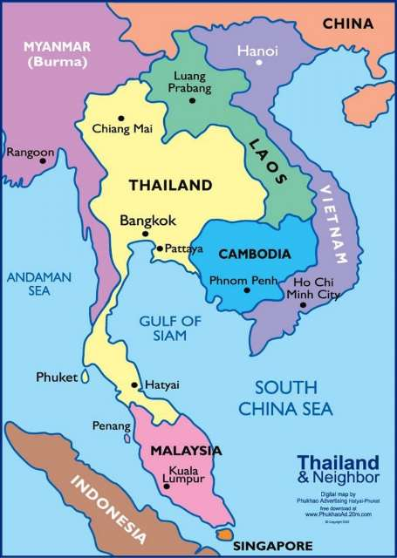
… further facts, issues
domestic or international use of biodiversity
national and international legislation
legal and illegal trade activities
traceability of species and products thereof
sustainability of species and derived products utilized
Non-CITES but nationally protected species are smuggled out of their country; once they have reached EU destinations, there is no regulatory mechanism to seize these imports.
Maps: Southeast Asia: Source: http://mercnet.me/wp-content/uploads/download-southeast-asia-political-map-quiz-major-tourist-within-1.jpg;

Slide 5
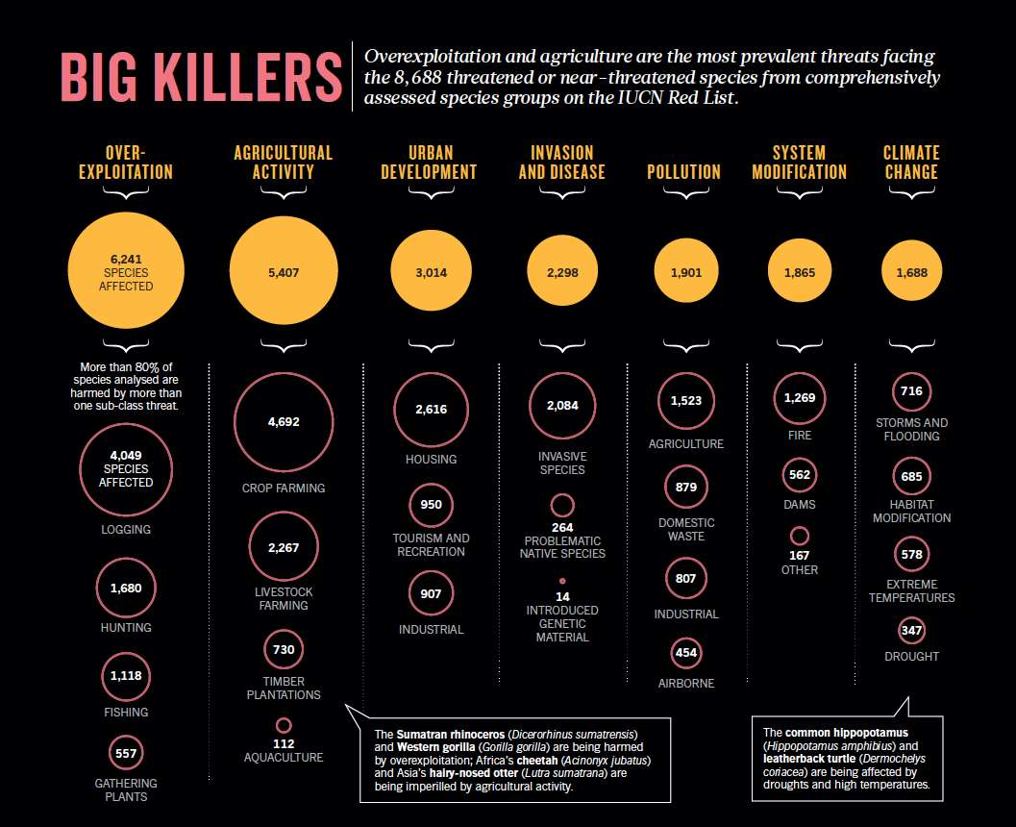
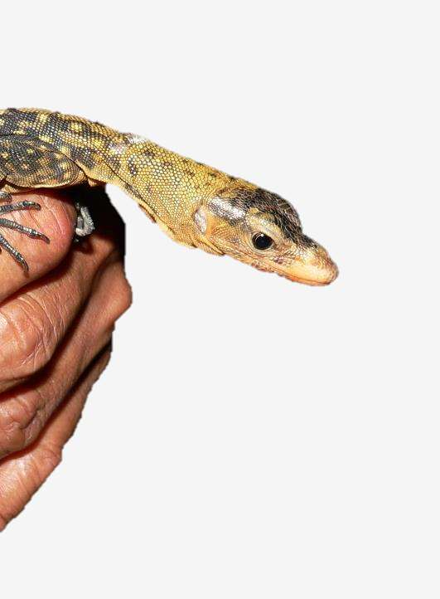
Juvenile captured Varanus melinus, Indonesian reptile farm
Maxwell et al. (2016) The ravages of guns, nets and bulldozers. Nature 536: 143-145.

Slide 6
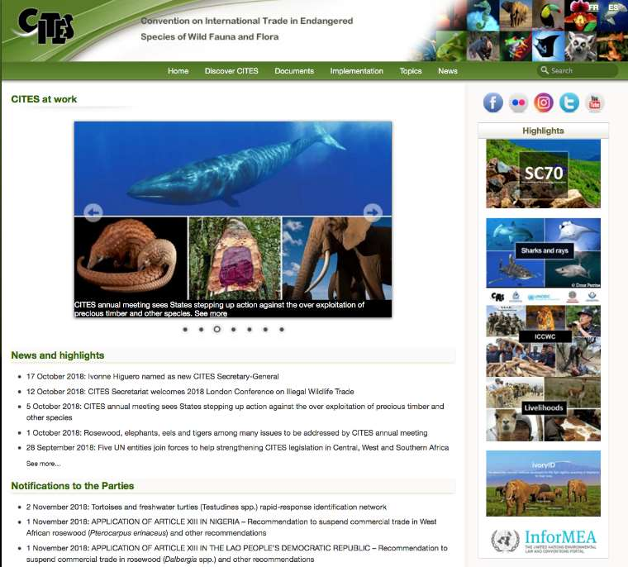
Convention on International Trade in Endangered Species of Wild Fauna and Flora, CITES
(2) Amphibians & Reptile Species listed on CITES and EU Wildlife Trade Regulations
to ensure that no species of wild fauna and flora becomes or remains subject to unsustainable exploitation because of international trade
CITES regulates trade in species of conservation concern through a system of permits and licences, and foremost three appendices depending on the degree of protection.
Appendix I includes species threatened with extinction, only permitting trade in exceptional circumstances, e.g., for scientific purposes
Appendix II includes species not necessarily threatened with extinction, but in which trade must be controlled in order to avoid overexploitation
Appendix III contains species that are protected in at least one country, that requests support of other CITES Parties to regulate trade of that species.
Source: https://www.cites.org/eng#
Notes:
Parties to CITES act together by regulating trade in species listed in one of the three Appendices of CITES. Trade in specimens of CITES Appendix-listed species requires a permit or certificate issued by a national Management Authority. The Management Authority can only issue these permits when the national Scientific Authority has advised that the trade will not have a harmful impact on the status of the wild population (see also Annex I for further information).
The Convention on the International Trade in Endangered Species of Wild Fauna and Flora (CITES) regulates the trade in species of conservation concern between its 183 signatory countries, through a system of appendices and permits/ licenses.
Unfortunately, despite being an excellent resource, the data collection relies on the submission of annual reports, which can be undermined by weak domestic legislation and governance (Reeve, 2006). Conse- quently, there are inconsistent reporting standards and submission of annual reports across the signatory countries, leading to potential underreporting issues and undermining the reliability of some data. More broadly, a lack of integration with economic, human development and governance issues driving wildlife trade, the low priority given to CITES, and a dearth of resources for its implementation has undermined the ability of CITES to monitor legal trade.

Slide 7
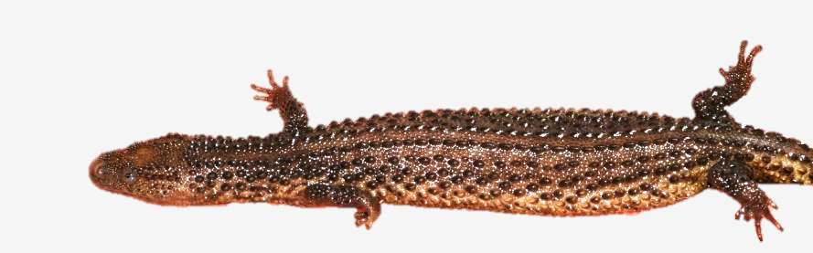
CITES Species (incl. CoP18 species)
 | Appendix I | Appendix II | Appendix III | Species known | Source
Amphibians | 24 | 174 | 4 | 8,105 | Frost (2019) Amphibian Species of the World: an Online Reference. Version 6.0, http://research.amnh.org/vz/herpetology/amphibia, accessed [27.11.2019]
Reptiles | 94 + 5 ssp. | 781 | 61 | 10,793 (date: July 2018) | Uetz et al. (eds.), The Reptile Database, http://www.reptile-database.org , accessed [27.11.2019]
Lanthanotus borneensis, housed/offered for sale in Germany
Notes:
Roughly 5,800 species of animals and 30,000 species of plants are protected by CITES against over-exploitation through international trade. They are listed in the three CITES Appendices. The species are grouped in the Appendices according to how threatened they are by international trade. They include some whole groups, such as primates, cetaceans (whales, dolphins and porpoises), sea turtles, parrots, corals, cacti and orchids. But in some cases only a subspecies or geographically separate population of a species (for example the population of just one country) is listed. The table below shows the approximate numbers of species that are included in the CITES Appendices as of 2 January 2017.

Slide 8
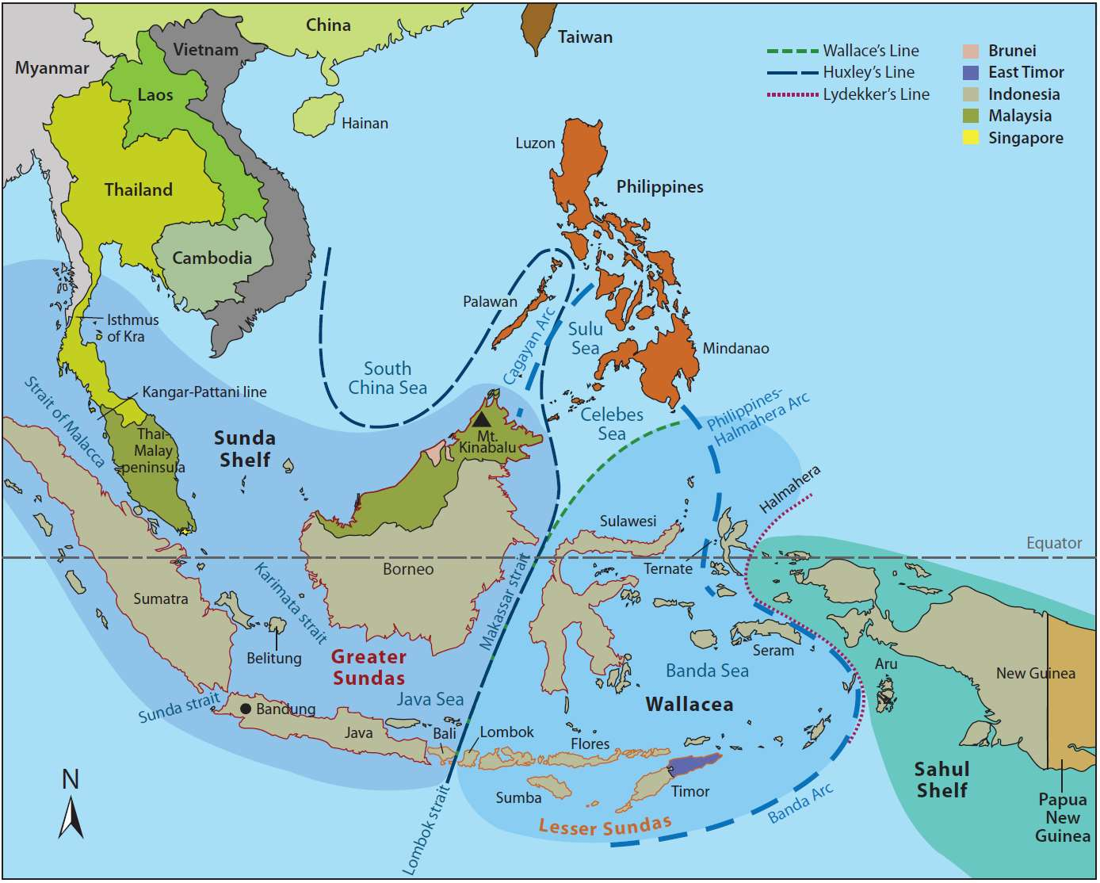










International reptile pet trade - CITES II species
CR
CR
CR
DD
EN
EN
VU
NA
DD
CR

Slide 9
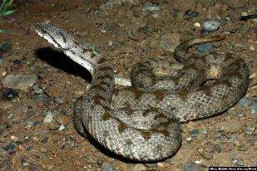
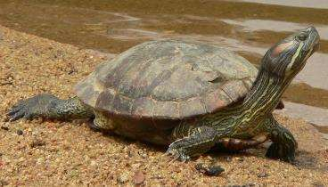
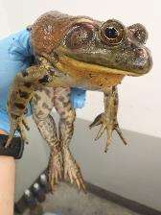
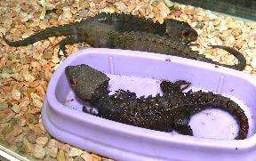
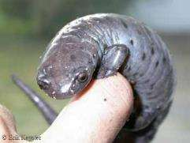
CITES in the EU
[European Wildlife Trade Regulation]
Annex A | all CITES I species some App. II and III species some non-CITES species
Annex B | all remaining App. II species some App. III species some non-CITES species
Annex C | all remaining App. III species
Annex D | some App. III species some non-CITES species
Photo credits: Montivipera latifii (Alireza Shahrdari Panah), Lithobates catesbeianus (Jonathan Colby); Bolitoglossa. dofleini (Erik Keyster)

Slide 10
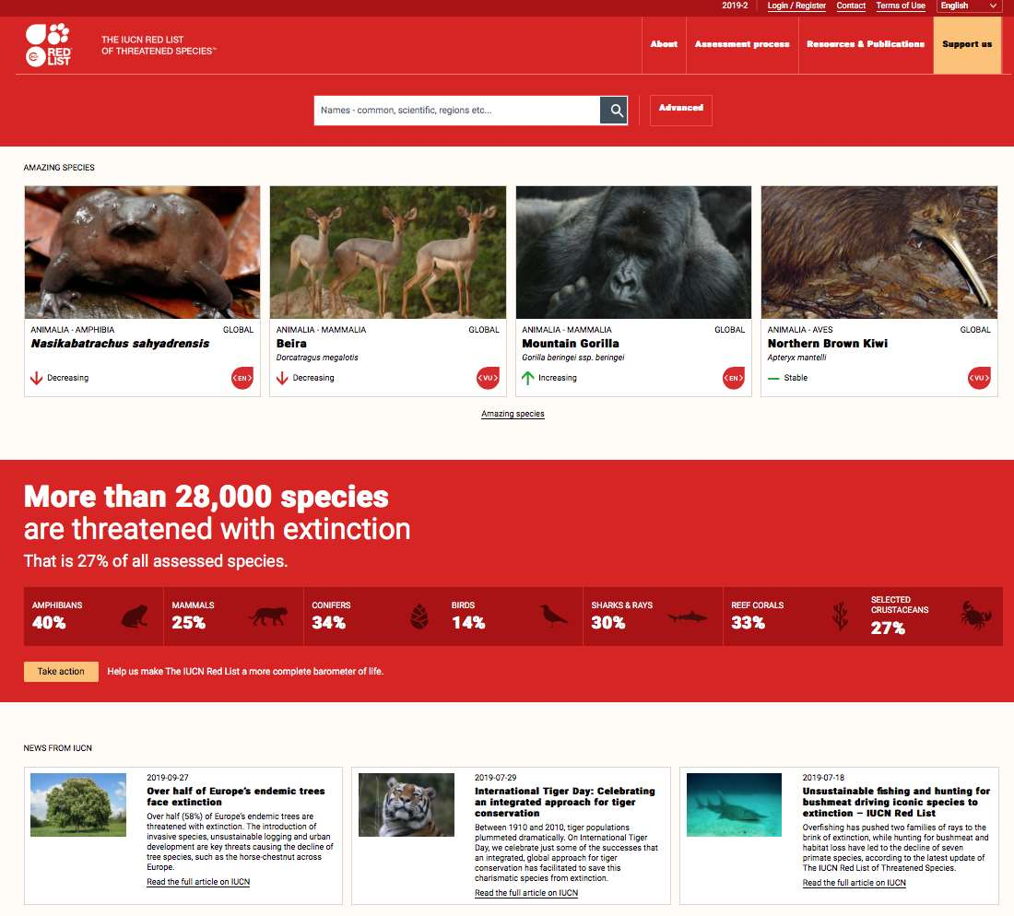
(3) IUCN Red listed amphibians & reptiles
Source: IUCN 2019. The IUCN Red List of Threatened Species. Version 2019-2. https://www.iucnredlist.org
accessed 27.11.2019

Slide 11
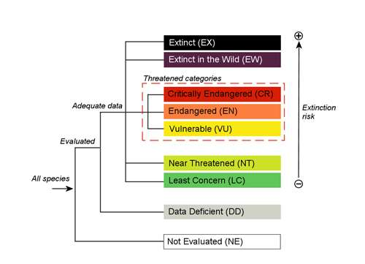
Structure of the IUCN Red List categories
Source: IUCN (2012) IUCN Red List Categories and Criteria: Version 3.1. Second edition. Gland, Switzerland and Cambridge, UK: IUCN. iv + 32pp.

Slide 12
IUCN Red List stats
TAXON [No. CITES] | Total No. IUCN Red List | No. threatened (CR, EN, VU) [population decreasing] | All numbers utilized* [numbers utilized and threatened] | No. Data Deficient | No. species [latest assessments dates]
Amphibians [202] | 6771 | 2157 [1663] | 593 [188] | 1404 | 2595 [year: 2004]
Reptiles [936] | 7541 | 1367 [659] | 1030 [275] | 1126 | 1775 [period: 2010-1996]
* Selected criteria: Food-human; Pets; Research; Specimen collecting; Medicine – human & veterinary

Slide 13
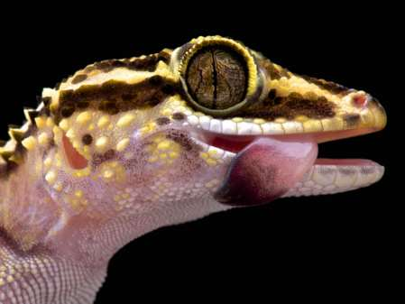
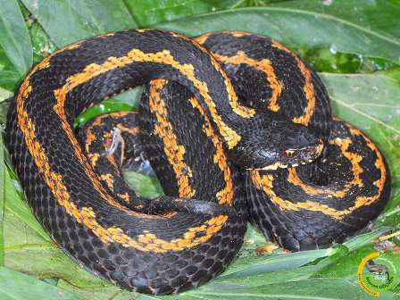
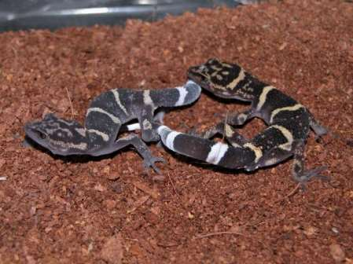
Examples of Non-CITES reptile species threatened and involved in international trade
 | IUCN RED LIST STATUS | Source
Paroedura lohatsara | Critically Endangered | Raxworthy, C.J., Ratsoavina, F., Rabibisoa, N., Rakotondrazafy, N.A. & Bora, P. 2011. Paroedura lohatsara. The IUCN Red List of Threatened Species 2011: e.T172898A6937991. http://dx.doi.org/10.2305/IUCN.UK.2011-2.RLTS.T172898A6937991.en. Downloaded on 06 November 2018.
Vipera kaznakovi | Endangered | Tuniyev BS (2016) Rare species of shield-head vipers in the Caucasus. In: Nature Conservation Research 3, 11–25.
Goniurosaurus toyamai, G. yamashinae | Critically Endangered | https://www.traffic.org/publications/reports/reptiles-and-amphibians-endemic-to-japans-nansei-islands-japanese
Photo credits:
P. lohatsara: http://rivista-cdn.reptilesmagazine.com/Paroedura-lohatsara-shutterstock_286368056.jpg?ver=1524253164;
V. kaznakovi: http://bayramgocmen.com/album/upload/2013/01/22/20130122072355-3faa9dde.jpg ;
G. yamashinae: https://www.reptarium.cz/content/photo_03/Goniurosaurus-yamashinae-03000016973_01.jpg;

Slide 14
Viperidae spp. that are involved in the international pet trade and that all have a decreasing population trend
(according to their IUCN assessments).
Species | EWTR | CITES | IUCN | Year assessed
Crotalus catalinensis |  |  | CR | 2007
Vipera anatolica |  |  | CR | 2009
Vipera orlovi |  |  | CR | 2008
Montivipera wagneri | B | II | CR | 2009
Montivipera albizona |  |  | EN | 2009
Protobothrops mangshanensis | B | II | EN | 2012
Vipera kaznakovi |  |  | EN | 2009
Montivipera bornmuelleri |  |  | EN | 2006
Vipera dinniki |  |  | VU | 2009
Vipera ursinii | A | I | VU | 2009
Bothriechis aurifer |  |  | VU | 2007
Bothriechis rowleyi |  |  | VU | 2007
Vipera latastei |  |  | VU | 2009
Daboia deserti |  |  | NT | 2006
Daboia mauritanica |  |  | NT | 2006
Vipera barani |  |  | NT | 2009
Montivipera raddei |  |  | NT | 2009
Vipera transcaucasiana |  |  | NT | 2009
Crotalus horridus |  |  | LC | 2007
Daboia siamensis |  |  | LC | 2012
Pseudocerastes persicus |  |  | LC | 2010
Vipera aspis |  |  | LC | 2009
Crotalus adamanteus |  |  | LC | 2007
Vipera ammodytes |  |  | LC | 2009
Crotalus ruber |  |  | LC | 2007
Vipera berus |  |  | LC | 2009
Notes:
Viperidae spp. certainly represent one of the most charismatic and valuable species in terms of rarity and the geographical restricted range many species represent. Collectors and specialized herpetoculturists offer subspecies e.g., Gloydius blomhoffi siniticus or Vipera aspis hugyi or species/populations from certain regions, e.g., Vipera ammodytes from the Skutari lake in Montenegro or Atheris ceratophora from the Amani region in Tanzania. Also, several highly endemic species are offered as wild captures e.g., Matilda’s Horned Viper (Atheris matildae) and Ashe’s Bush Viper (Atheris desaixi).

Slide 15
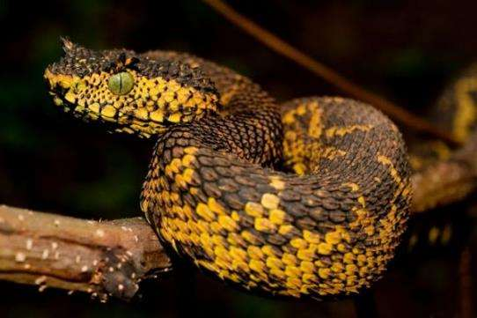
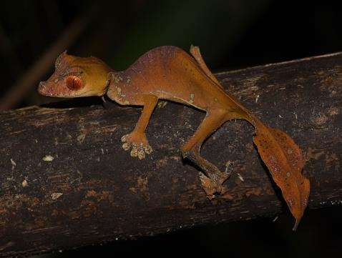
(4) Triggers & criteria of most-wanted species
New scientific descriptions of taxa included charismatic genera
Nationally and internationally protected species
Rarity, Isolated populations, micro-endemics, endemism
Endangerment
Colour pattern & taxon-characteristic morphological traits
Atheris matildae
* The exact locality record of the species in its scientific description was not provided, to protect it from illegal collectors
Uroplatus finaritra
* Because this species resembles U. phantasticus, it is difficult for collectors (who actively collect U. phantisicus for the pet trade) to tell the two species apart
Photo: https://natureology101.files.wordpress.com/2013/01/matildas-horned-viper.jpg?w=600&h=398
© Miguel Vences
Courchamp, F., Angulo, E., Rivalan, P., Hall, R.J., Signoret, L., et al., 2006. Rarity value and species extinction: the anthropogenic Allee effect. PLoS Biol. 4, e415. http://dx.doi. org/10.1371/journal.pbio.0040415.
Menegon, M., Davenport, T., Howell, K., 2011. Description of a new and critically endangered species of Atheris (Serpentes: Viperidae) from the southern highlands of Tanzania, with an overview of the country's tree viper fauna. Zootaxa 3120, 43–54.
RATSOAVINA, FANOMEZANA MIHAJA; ACHILLE P. RASELIMANANA, MARK D. SCHERZ, ANDOLALAO RAKOTOARISON, JARY H. RAZAFINDRAIBE, FRANK GLAW, MIGUEL VENCES 2019. Finaritra! A splendid new leaf-tailed gecko (Uroplatus) species from Marojejy National Park in north-eastern Madagascar. Zootaxa 4545 (4): 563–577
https://www.smithsonianmag.com/smart-news/new-leaf-tailed-gecko-discovered-madagascar-180971338/

Slide 16
Rare and nationally protected species
Biete Schlangen | Gawein Bruckner | 3425 Langenlebarn
 |  | So, 09. Feb 14 16:28
0,0,8 A. broadleyi. CBB 2014 / à EUR 150,- 1,3 A. ceratophora: WC 12 / Zuchtgruppe / 1,0: patternless oliv / 0,3: 2x gelb, 1x getigert / zusammen € 800,- 0,3 A. ceratophora: WC 12 / Armani Region, klein bleibend / zusammen € 600,- 0,1 A. desaixi: sehr groß / Zuchttier / WC 2011 / adult / € 1000,- 1,0 A. squamigera: CBB 13 / € 150,- 0,1 A. chloroechis: WC 11 / adult / € 150,- Alle Tiere fressen Mäuse von der Pinzette. Nur eine nicht refundierbare Anzahlung von 50% des vereinbarten Preises gilt unsererseits als Reservierung. Übergabe in Hamm / Abholung in Wien oder Langenlebarn. Mail gawein@gawein.at Mob 0043 664 435 48 70
Fr, 21. Feb 14 20:00
For sale 2.1 Atheris broadleyi 2012 1.2 Crotalus mitchellii mitchellii 2013 0.1 Naja naja naja 2013 0.1 Phylodrias baroni 2006 more info and photo on www.reptiles-nest.com ungeprüfter User
Biete Schlangen | Ales reptiles-nest
 |  | Fr, 21. Feb 14 19:54
For sale in Hamm 1.2 Bitis parviocula 2012-13 1.1 Bitis cornuta - Springbok - 2013 1.1 Boiga dendrophila 12.2013 1.0 Crotalus triseriatus armstrongi 12.2012 1.1 Naja nivea - yellow 2013 more info on www.reptiles-nest.com ungeprüfter User

Slide 17
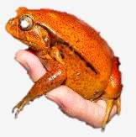
Influential components that direct international trade in wildlife
(5) Scientific uncertainties prevail in legally traded species
Policies
[%]
Lobby
[%]
NGOs
[%]
Biology
[%]
Science [%]
Economy [%]
Rarity
Conservation status
CITES listing
Distribution
Colour pattern, specific morphology
Value
Rarity
Conservation status
CITES listing
Distribution
Colour pattern, specific morphology
Value
Economy [%]
Science [%]
Illegal trade
Notes:
Abstract and simple chart, in reality more dynamic situation; how is science used? What scientific sources contribute to decision making?

Slide 18
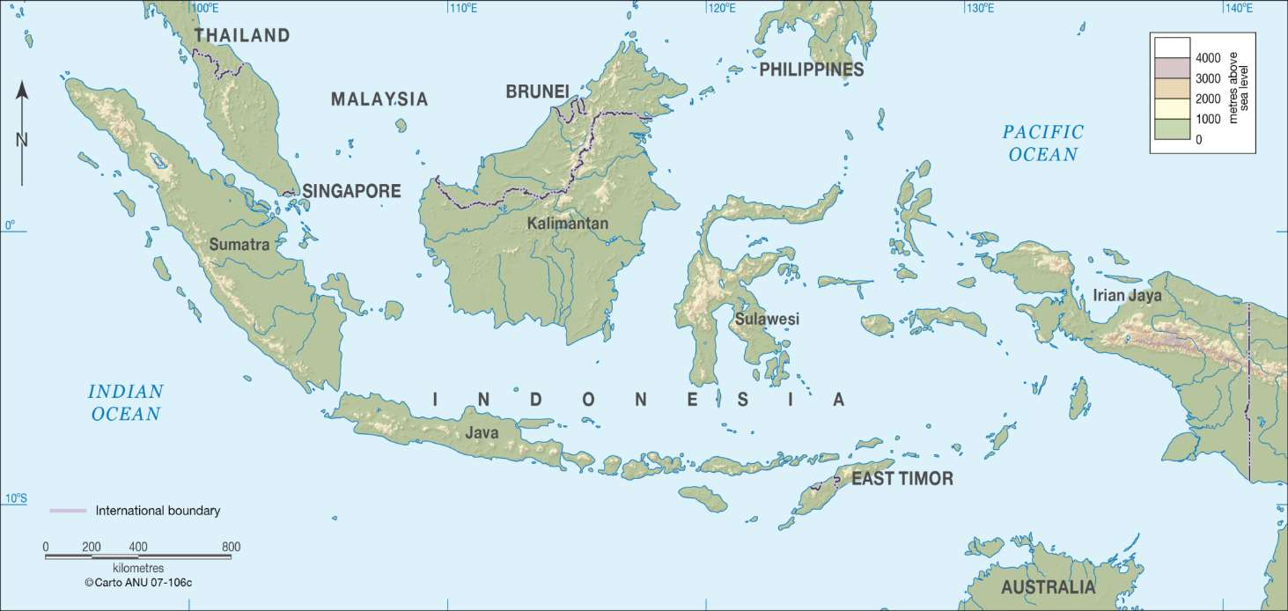
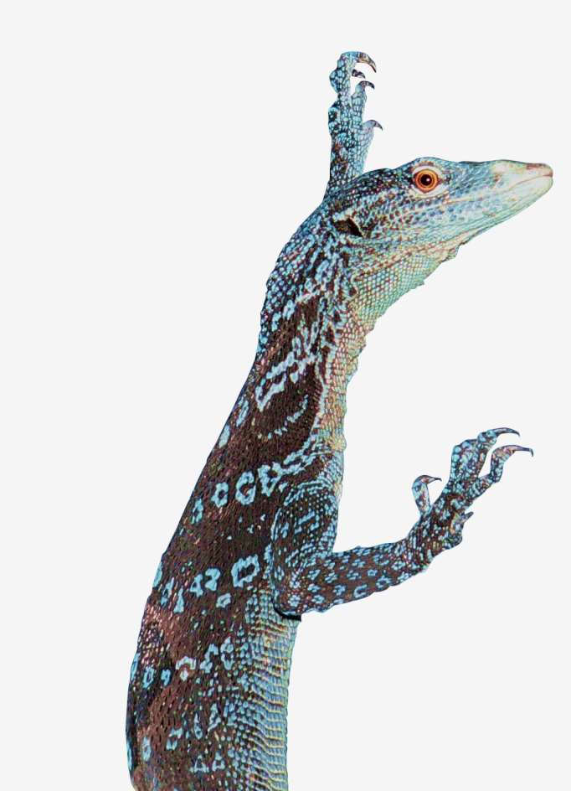
Evaluating extinction risk of Varanus macraei
V. lirungensis
V. macraei
Source: http://t1.gstatic.com/images?q=tbn:ANd9GcS9RcOAvBYd_vK1FaCSpdebmCFwF4_UexXjVpPk6lQmjkqBh5nOkzUr2g

Slide 19
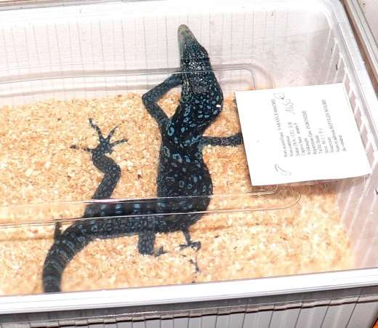
Live trade in Varanus macraei
Adult V. macraei, Hamm, March 2006
Life exports of Varanus macraei reported by Indonesia (red) and imports reported by importing countries (yellow in the period 2003-2018. In 2013, Indonesia did not report any exports until 22 August 2017, where past-due export data for 2013 (209 live specimens) was documented. Source: https://trade.cites.org – accessed 27 June 2017-4 Sept. 2019].
Notes:
Wie könnte man also die Nachhaltigkeit des gegenwärtigen Handels abschätzen, ohne populationsökologische Daten? In dem man z.B. Modelle einer PVA basierend auf demographische Parameter konstruiert > wie folgt

Slide 20
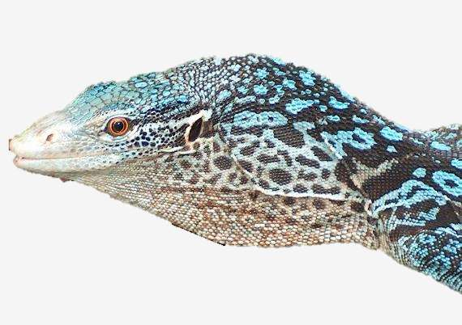
Legal trade of Varanus macraei is permitted (CITES App. II) despite the fact that there is no data on ...
... the population status of the species,
... actual annual off-take levels (seizures are reported),
... a sustainable or unsustainable trade through the making of an NDF
... other threats (e.g., illegal logging) that may detrimentally impact the population
and that
... the species is not protected in Indonesia
... very irregular and over years late reporting of annual export volumes through MA
© André Koch
What does this mean for conservation scientists?

Slide 21
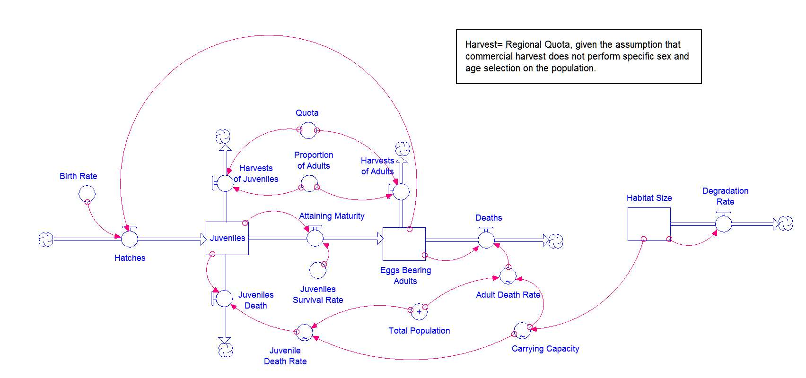
* Based on the huge amount of scientific uncertainties conservation scientists would need to model the extinction risk of a species
* One potential possibility would be a system dynamic approach (biological indicators), or
… apply a population viability analyses (PVA) that was originally used to assess
the extinction risk of threatened species, by applying the principles of population ecology.
,
Notes:
That was
A Method to identify identify sustainable indices?

Slide 22







Juvenile
Subadult
Adult
Egg-
hatchling
ФAd
ФJ
ФSub
σ *Фh *h
ϒ sub
ϒ Ad
F1 = min(Nf ,Nm )*Ѡ1*h
ϒ sub
ϒ Ad
(1- σ )*ФJ1 *h
ФJ2
ФSub
ФAd

Slide 23
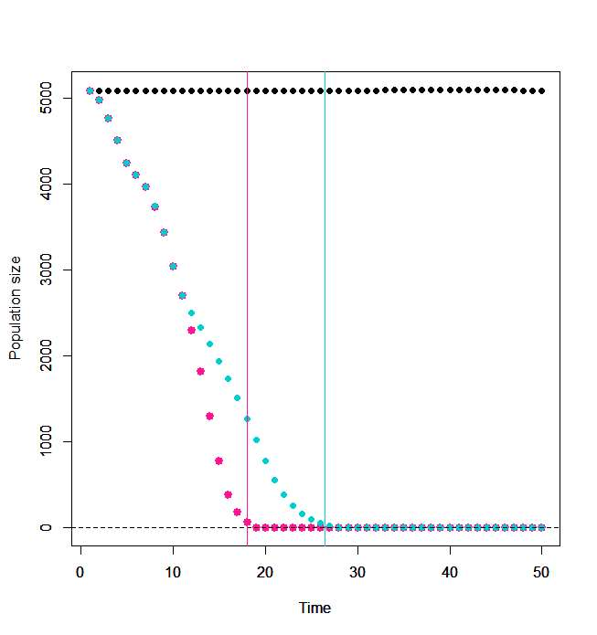
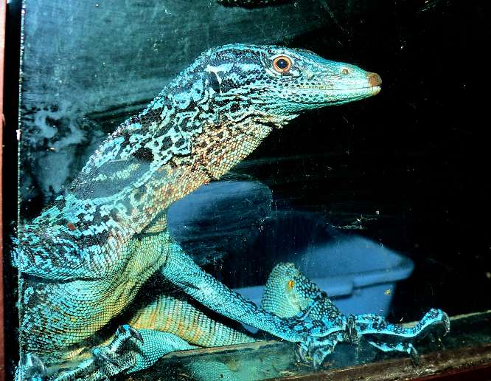

Demographic PVA [population viability analyses] model
CITES-trade data
Indicating no harvest offtake
Background data:
Batanta Isl.: 453-455km²
Population size of approx. 5000 animals
pop. density approx. 0.125 individuals/ha
Reproductive biological data (based on captive-bred specimens)
If trade volumes increase
trade volumes remain unchanged
Reptile farm, Indonesia.
Note: 27 Nov.,2019, a specimen of V.macraei was offered for sale in Japan for 220 000 JPY (approx. 1800 EUR). In 2017, five specimens were recorded at two retailers in Japan, for sale on average for approx. 1200 EUR.
Notes:
PVA - demographic model …consider juveniles, subadults and adults in trade in life cycle; only trade is considered as a threat, other e.g. logging activities are excluded.

Slide 24
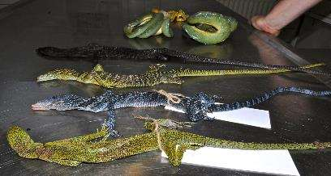
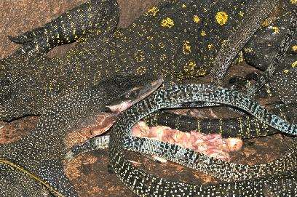
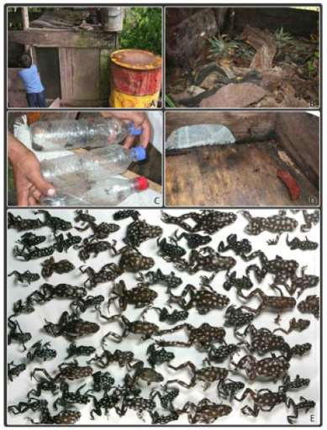
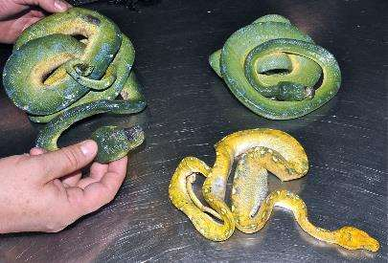
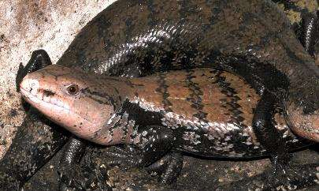
(6) Mortalities
*Intercontinental mortality rates are siltently tolerated, and data on mortalities prior to export from the point of harvest to the exporters premises are lacking and and there is evidence that these far outweigh those of intercontinental flights.
Left: Dead arrivals from Indonesia, winter import, Germany; centre: keeping conditions of wild specimens at a middleman in Indonesia; right: Illegal traffic and mortalities of poison frogs in Peru.
Brown et al. (2011) A taxonomic revision of the Neotropical poison frog genus Ranitomeya (Amphibia: Dendrobatidae). Zootaxa 3083: 1–120
Notes:
Dead Ranitomeya vanzolini and Excidobates mysteriosus (an endangered species) found hidden amongst a shipment of tropical fish and destined for a major distributor of frogs in Europe in 2005. Over 400 frogs were discovered in this shipment, concealed among tropical fish exports from Iquitos, Loreto, Peru.

Slide 25
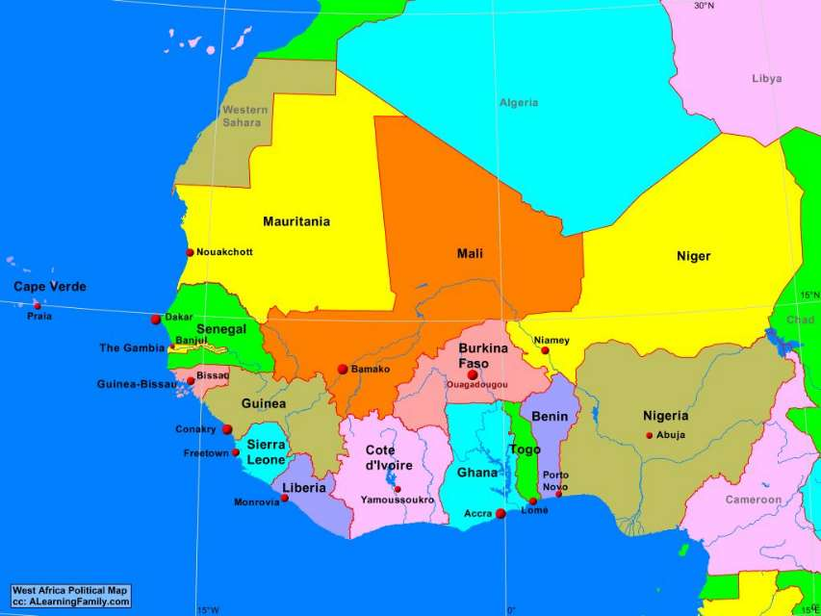
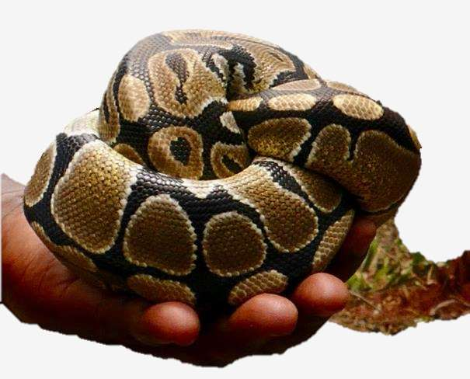
(7) Origin/source reporting issues
Exports of ball pythons from Western Africa
*the misreporting of sources documented and countries of origin (cross-border trade) have been reported.
Python regius, Togo
de Buffrénil V (1995) Les élevages de Reptiles du Bénin, du Togo et du Ghana. Rapport d’étude réalisée pour le Secrétariat de la CITES, Juin 1995: 1–23.
Gorzula S, Nsiah WO, Oduro W (1997) Survey of the Status and Management of the Royal Python (Python regius) in Ghana. Part 1. Report to the Secretariat of the Convention on International Trade in Endangered Species of Wild Fauna and Flora (CITES). Geneva, Switzerland, 1-38.
Map Source: Western Africa: http://www.alearningfamily.com/main/wp-content/uploads/2019/08/AfricaWestPolitical.jpg

Slide 26
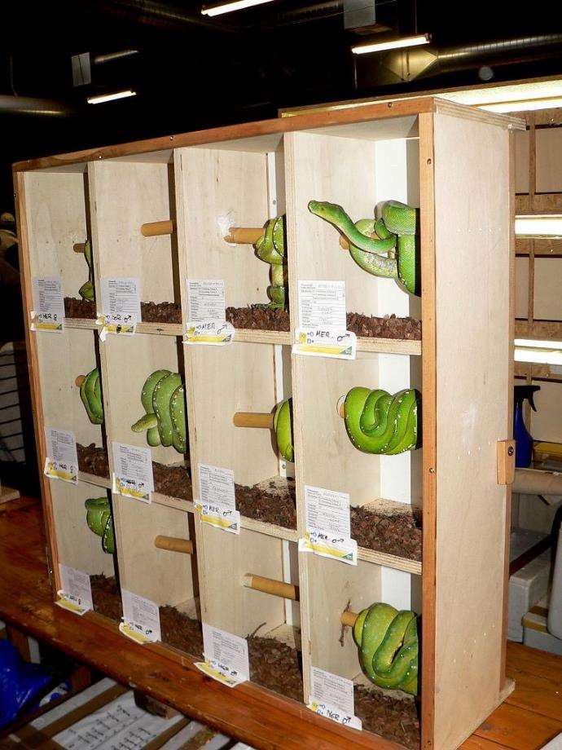
Wild or captive bred
Nationally protected species are laundered as farmed individuals, according to Indonesian legislation these are supposed to be captive-bred (F2)
Collectors know when species in demand hatch in the wild; these are captured and laundered as captive-bred e.g., Chlamydosaurus kingii
Lyons, J.A., Natusch, D.J., 2011. Wildlife laundering through breeding farms: illegal harvest, population declines and a means of regulating the trade of green pythons (Morelia viridis) from Indonesia. Biol. Conserv. 144, 3073–3081. http://dx.doi.org/ 10.1016/j.biocon.2011.10.002.
Adult Morelia viridis offered as captive-born specimens from Indonesia at the Hamm fair, Germany

Slide 27
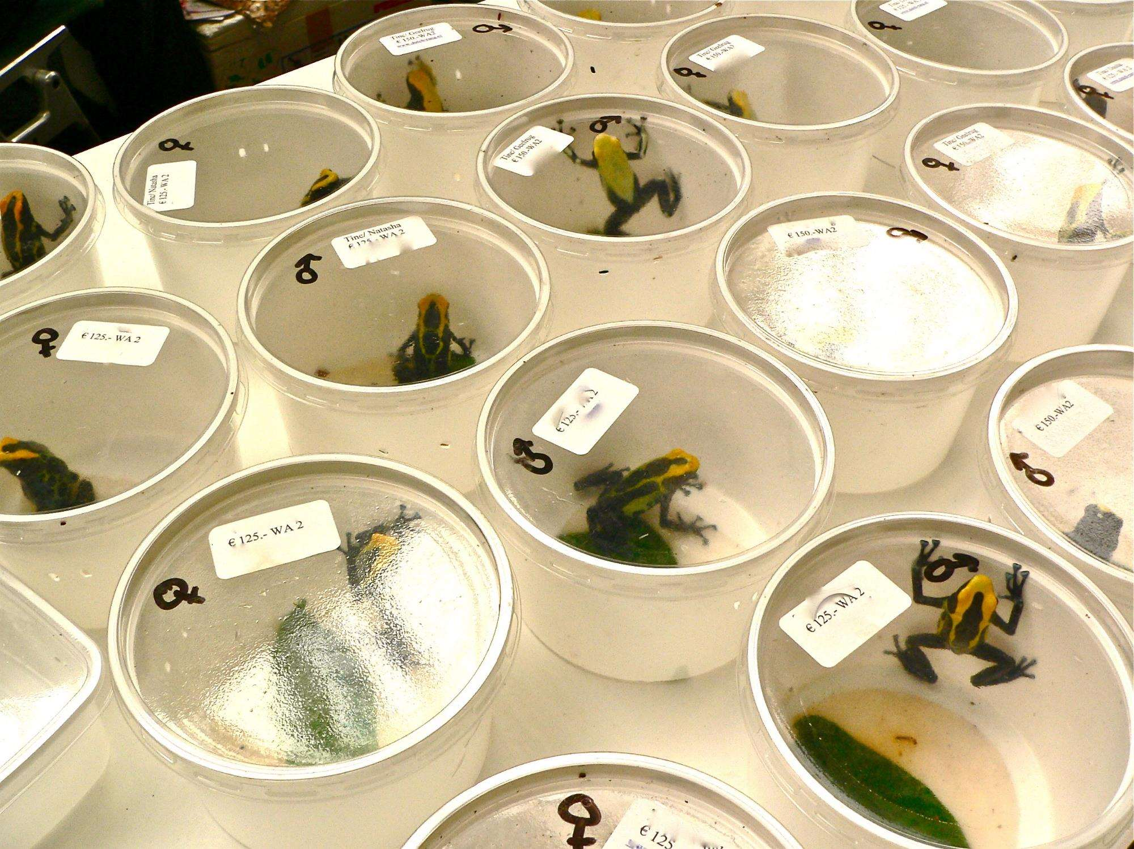
(8) Diseases
Amphibians
Global (fungal) amphibian diseases (e.g., ranavirus, Bd, Bsal)
  International trade contributes to the spread of these diseases
  Cross-infection remains one main issue, and standardized hygiene protocols yet need to be implemented
Reptiles
Diseases and their spread with reptiles traded intercontinentally are slowly becoming a more popular topic in conservation science
Zoonotic diseases have been identified in the trade with tortoises.
Rowley et al. (2007) Survey for the amphibian chytrid Batrachochytrium dendrobatidis in Hong Kong in native amphibians and in the international amphibian trade. Diseases of aquatic organisms. 78: 87-95.
Martel et al. (2014) Recent introduction of a chytrid fungus endangers Western Palearctic salamanders. Science 346: 630-631
Bruce et al. (2018) Zoonotic potential of Salmonella enterica carried by pet tortoises. The Veterinary record. DOI:10.1136/vr.104457

Slide 28
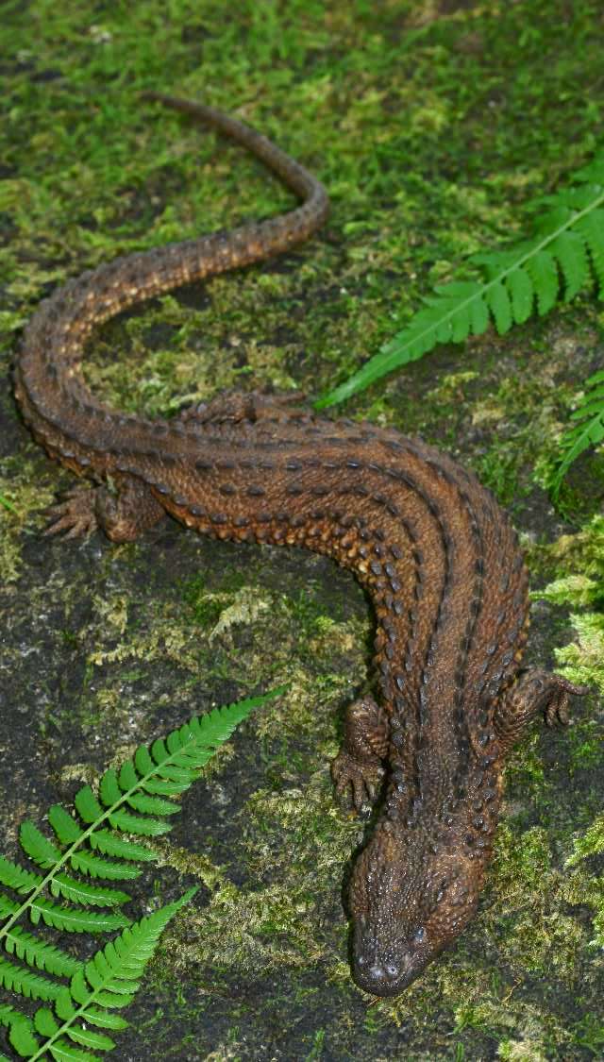
(9) Illegal trade
Anecdotal information on the species’ distribution in West Kalimantan was first published by Auliya (2006). It is assumed that trade in the species was initially reported in 2012, and there are indications (evidence cannot be provided) that live specimens offered for sale have been sourced from West Kalimantan. The first occurrence of the species in Indonesian Borneo was published online in September 2012 (Yaap et al. 2012). In their publication the authors note “Geographical coordinates were taken, however, due to the species’ rareness and its high conservation value; it cannot be ruled out, that pet reptile collectors and traders may misuse this additional information. We have therefore retained GIS data”. A few months after this discovery was published, in early 2013, requests from Indonesian nationals to co-authors of the study were received for more precise locality details of the species in West Kalimantan (in litt. 3 March 2013; to Auliya).
In April 2013, a new reptile zoo in Kawazu, Shizuoka, Japan, "i-Zoo”, displayed information and an image of a Lanthanotus feeding on an earthworm, and apparently a female and male specimen were maintained (in litt. 17-18 April 2013, to Auliya). According to an informant, these specimens originated from Sarawak, and this information was retrieved long before the issue was internationalized, which was ca. end of February 2013 (in litt. 3 September 2015 to Auliya) (also see http://izoo.co.jp/cando/pg129.html).
In early June 2014, a pair of the species was first offered in Hamm (Germany), the world’s largest reptile fair by two Czech nationals and by a German national (in litt., 3 June 2014 to Auliya).
In July 2014, the species was displayed in Russia and France (in litt. 8 July 2014 to Auliya).
In 2014, during a herpetological conference in Germany, a German national reported the discovery of more than 20 specimens; however according to rumors during that meeting, 36 live specimens were currently located in Germany (in litt. 9 Oct. 2014, to Auliya); at this stage this information could not be verified. Information provided in this presentation was planned to be published, and indeed was published by Langner (2017).
Near Kuala Lumpur, in Malaysia, several specimens were for sale; that are also available in Jakarta (in litt. 29 August 2015 to Auliya).
In August 2015, numerous individuals were spotted in West Kalimantan (Pontianak?) for sale; one specimen was distinctly dark almost black and sold to Germany (in litt., 30 August 2015 to Auliya).
In 2015, one adult and one juvenile were offered from Sarawak (in litt. 30 August 2015, to Auliya).
December 2015, 10 specimens were seized at Jakarta airport (WCS Wildlife Crimes Unit, January 2016).
In March 2016, a seizure of 17 specimens was reported from Supadio airport, Pontianak, West Kalimantan (Indonesia). [http://regional.kompas.com/read/2016/03/15/17180021/Paket.Bertuliskan.Mie.Ramen.Isinya.Biawak.Tak.Bertelinga – date accessed 20 March 2016]
According to the TRAFFIC Newsletter February 2016, the Earless Monitor has been reported from nine countries outside its range, such as USA, Germany, Japan, United Kingdom, Hong Kong, Czech Republic, France, Ukraine and Russia.
In Oct./Nov. 2017 a seizure of one specimen of L. borneensis at Supadio International Airport, West Kalimantan Province, Indonesia
© Indraneil Das

Slide 29
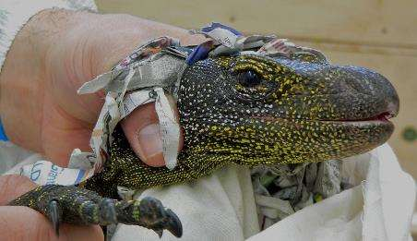
(10) Summarizing major issues/challenges
EU exploits the weak enforcement in the countries of origin/export
Non-CITES and nationally protected species entering the EU can not be seized
CITES Appendix II species that are threatened in the IUCN Red List are legally traded
CITES policies lack clear rules and advanced standards for data collection, analysis, and review; i.e. inconsistent reporting standards and submission of annual reports across CITES member States result in potential underreporting issues and undermine the reliability of data
Many trade decisions are made on the basis of scientific uncertainties often without information on pop. status, (annual) pop. dynamics, pop. trends, information on abundance, carrying capacity, etc.
Many non-CITES species are threatened and involved in the international trade
Endemic, range-restricted species are the most threatened by the international legal and illegal trade
For some wide-ranging species harvest regimes are dynamic and complex complicating and disguising true harvest locations/origins
Trade is also permitted despite the knowledge of various other threats a species is exposed to e.g., habitat loss, pollution, climate change, …
Trade is extremely dynamic and adapts quickly to changes in the legal framework
Conservation science is challenged in order to identify the unsustainable use of species
Sources and in certain species the countries of origin documented in CITES export permits can often deceive law enforcement officials, thus a sustainable/traceable trade is not given!
There is no disease control of amphibians and reptiles crossing borders, and cross infection is highly likely at reptile fairs
Varanus salvadorii, seized in Munich

Slide 30
(11) Recommendations
The elaboration of a positive list of species that can be traded, taking into account the major issues (as aforementioned) as a precautionary measure to address consumer responsibility would potentially achieve a legal, sustainable, traceable and transparent trade with live amphibians and reptiles.
Nevertheless, governments, organisations and trade stakeholders need to be made financially more accountable to support conservation scientific oriented research (e.g., field studies on the population status of selected species and wildlife forensics).

Slide 31
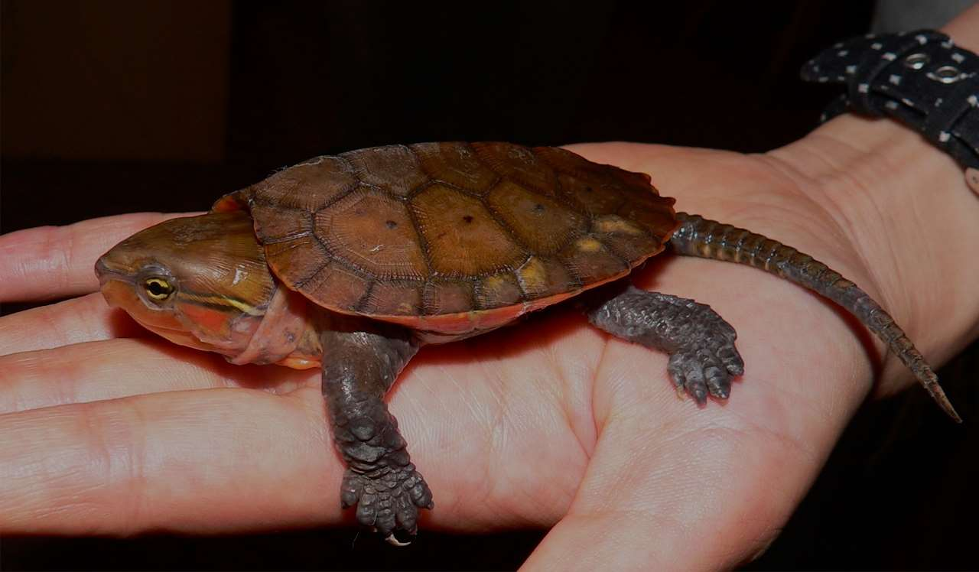
Thank you for your attention
Platysternon megacephalum,
at a trader in Japan, linked Czech
and German nationals

