Slide 1
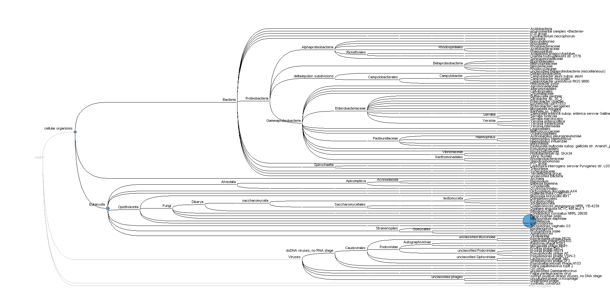
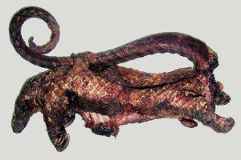
Pathogens discovery from imported meat seized at Brussels Airport (2017-2018).
Mutien Garigliany Veterinary Pathology
mmgarigliany@uliege.be

Slide 2
Growing awareness of European and National authorities on the issue of illegally imported bushmeat
Several tons per month for many European airports
It threatens the biodiversity in the countries of origin
Introduction
Methods
Results and Discussion
Conclusions

Slide 3
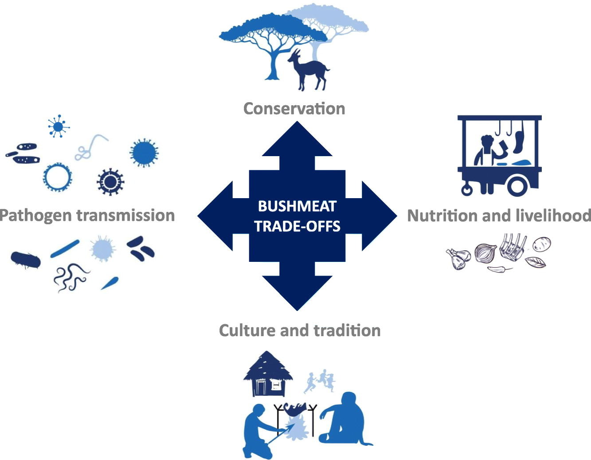
It threatens the biodiversity in the countries of origin
Introduction
Methods
Results and Discussion
Conclusions
Pruvot et al. (2019)

Slide 4
Zoonosis: “any disease or infection that is naturally transmissible from vertebrate animals to humans”
(http://www.who.int/zoonoses/en/)
Reverse zoonosis
Introduction
Methods
Results and Discussion
Conclusions
Robert Koch Institut

Slide 5
> 6 out of every 10 known infectious diseases in people are spread from animals
75% of new or emerging infectious diseases in people are zoonotic
Zoonoses are responsible for 2.5 billion cases of human illness and 2.7 million human deaths worldwide each year
WHO: “new pathogens from animals particularly viruses remain unpredictable and continue to emerge and spread…”
Introduction
Methods
Results and Discussion
Conclusions

Slide 6
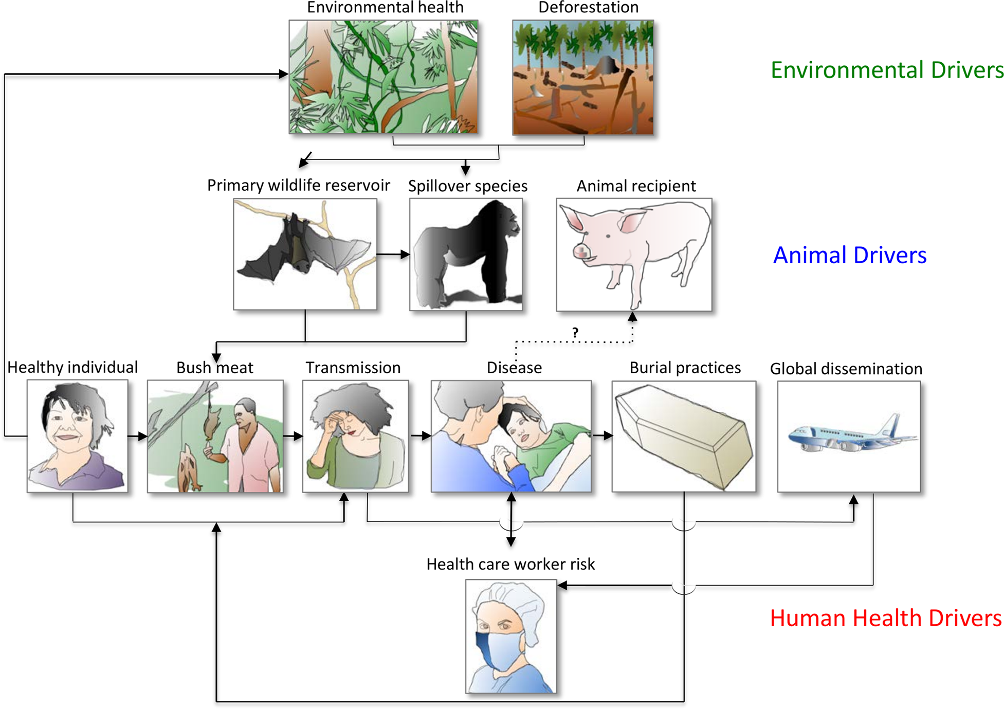
Lessons learned from Ebola…
Introduction
Methods
Results and Discussion
Conclusions
Mwangi et al. (2016)

Slide 7
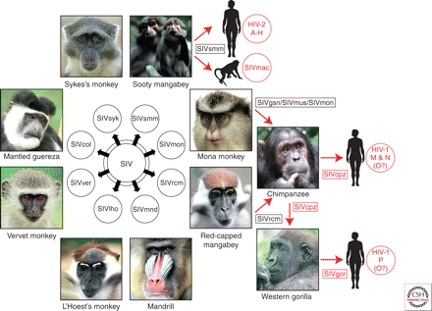
Lessons learned from HIV…
Introduction
Methods
Results and Discussion
Conclusions
Sharp & Hahn (2011)

Slide 8
Introduction
Methods
Results and Discussion
Conclusions

Slide 9
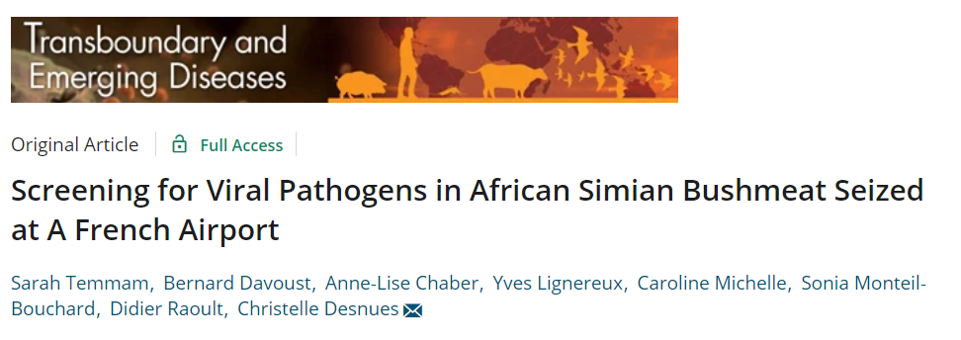
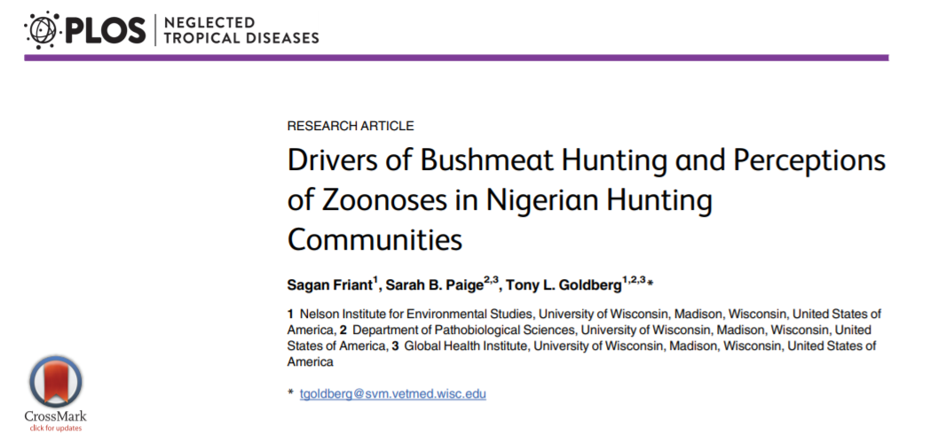
Introduction
Methods
Results and Discussion
Conclusions

Slide 10
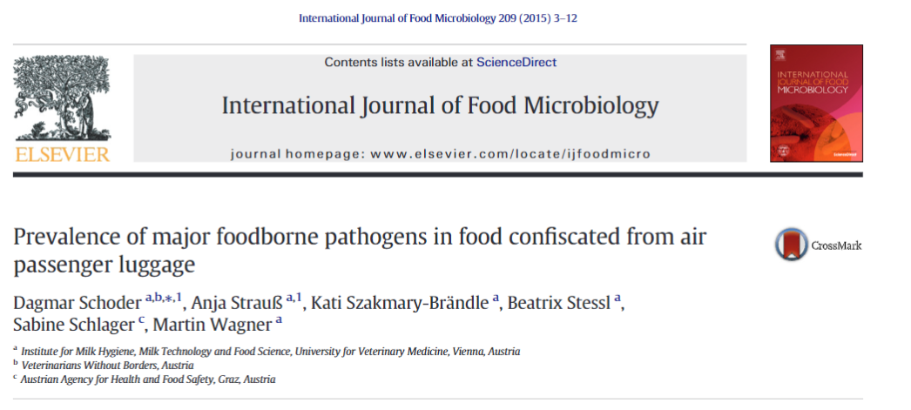
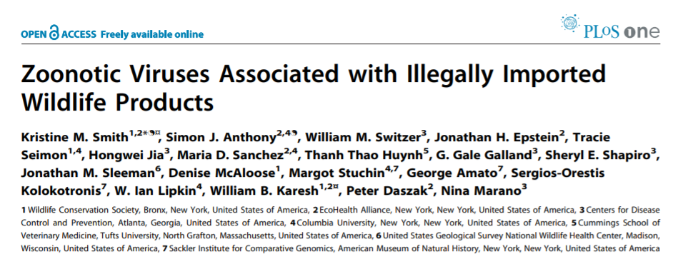
Introduction
Methods
Results and Discussion
Conclusions

Slide 11
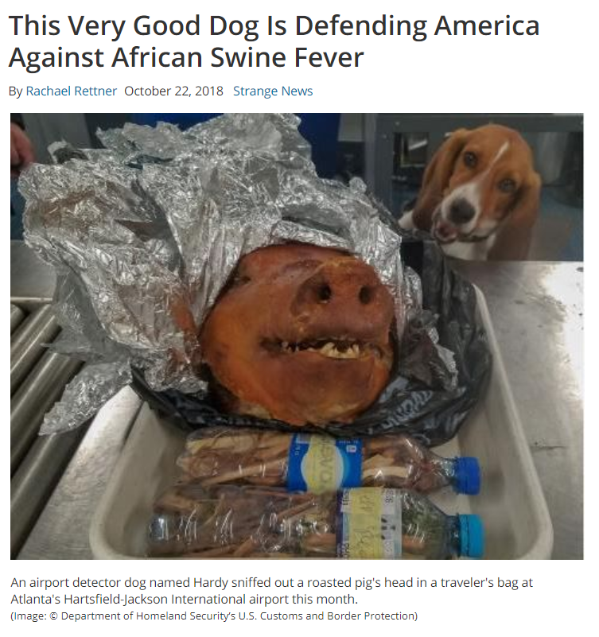
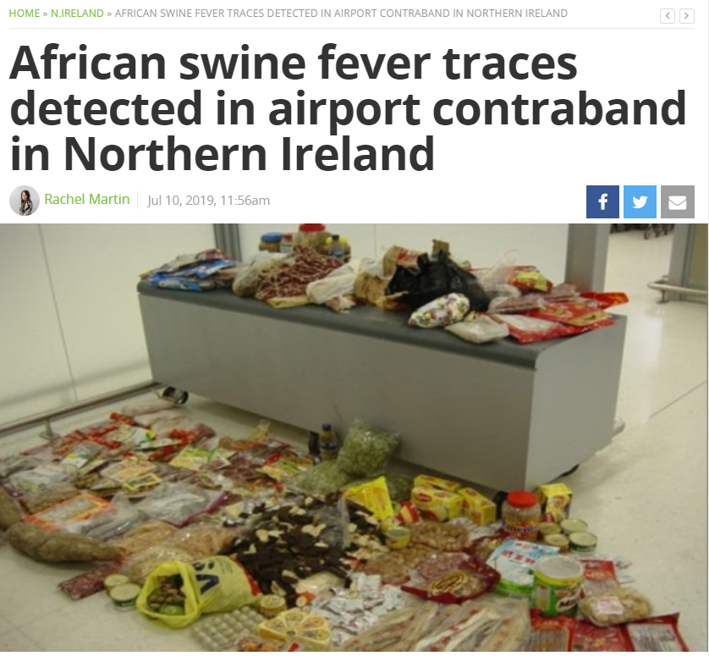
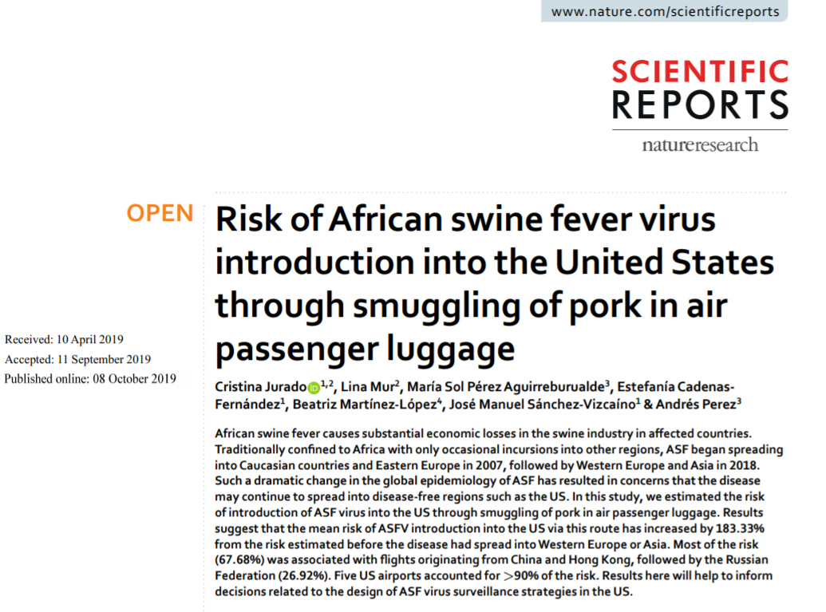
Introduction
Methods
Results and Discussion
Conclusions

Slide 12
Objectives of the pilot study:
Detect potential pathogens in the samples collected during the FPS Public Heath study on the identification of illegal CITES meat samples seized in Belgian airports
Using de novo methods
Listing and risk evaluation
Introduction
Methods
Results and Discussion
Conclusions

Slide 13
Samples:
A total of 61 meat samples seized at Zaventem airport in 2017/2018 from sub-Saharan Africa
Collected from « leaking luggage » searches or during systematic controls («BACON actions»)
Species identification had been performed molecularly (metabarcoding) or visually
Mix of bushmeat and domestic meat
Introduction
Methods
Results and Discussion
Conclusions

Slide 14
List of biological agents considered:
A list of key pathogens was established based on the scientific literature (Kurpiers et al., 2015; Cantlay et al., 2017)
It was supplemented using the list of OIE to include non zoonotic pathogens with a significant economic impact
Viruses, bacteria, parasites
Introduction
Methods
Results and Discussion
Conclusions

Slide 15
List of biological agents considered:
VIRUSES
African horse sickness virus | Infectious bursal disease virus
African swine fever virus | Japanese encephalitis virus
Aujeszky's disease virus (Suid Herpesvirus 1) | Lagos bat virus
Avian metapneumovirus | Lassa fever virus
Avian paramyxovirus-1 | Lumpy skin disease virus
Avihepatovirus DHV-1 and DHV-3 | Lymphocytic choriomeningitis virus
Bluetongue virus | Marburg virus
Bovine Herpesvirus-1 | Mokola virus
Bovine leukaemia virus | Monkeypox virus
Bovine viral diarrhoea virus | Nairobi sheep disease virus
Caprine arthritis/encephalitis virus | Nipah virus
Cercopithecine herpesvirus-1 | Orf virus
Classical swine fever virus | Peste des petits ruminants virus
Cowpox virus | Porcine reproductive and respiratory syndrome virus
Crimean Congo haemorrhagic fever virus | Rabies/Lyssaviruses
Duvengahe virus | Reoviruses
Eastern Equine encephalitis virus | Rift Valley fever virus
Ebola virus | Rinderpest virus
Epizootic haemorrhagic disease virus | SARS Coronavirus
Equid herpesvirus-1 | Sheep pox and goat pox
Equine infectious anaemia virus | Simian foamy virus
Equine viral arteritis virus | Simian type D retrovirus
Foot and mouth disease virus | Simian virus 40
Gallid Herpesvirus-1 | Swine Coronavirus
Henipaviruses | Swine influenza virus
Hepatitis E virus | Venezuelan equine encephalitis virus
Influenza A virus | Visna-Maedi virus
Human immunodeficiency virus | West Nile fever
Human T-lymphotropic virus | Western Equine encephalitis virus
Infectious bronchitis virus
Introduction
Methods
Results and Discussion
Conclusions

Slide 16
List of biological agents considered:
BACTERIA (Genus level only - 16S metagenetics)
Anaplasma spp.
Bacillus anthracis
Bartonella henselae
Brucella spp.
Burkholderia mallei
Campylobacter spp.
Chlamydia psittaci
Chlamydophila spp.
Coxiella burnetii
Dermatophilus congolensis
Edwardsiella tarda
Ehrlichia ruminantium
Erysipelothrix rhusiopathiae
Escherichia coli (VTEC)
Francisella tularensis
Leptospira spp.
Mycobacterium avium ssp. Paratuberculosis
Mycobacterium tuberculosis complex
M. agalactiae, M. capricolum ssp. Capricolum, M. mycoides subsp. Capri., M. putrefaciens
Mycoplasma capricolum subsp. Capripneumoniae
Mycoplasma gallisepticum
Mycoplasma mycoides subsp. Mycoides SC
Mycoplasma synoviae
Other Mycobacterium spp.
Pasteurella spp.
Salmonella spp.
Shigella spp.
Streptococcus spp.
Taylorella equigenitalis
Yersinia spp.
Introduction
Methods
Results and Discussion
Conclusions

Slide 17
List of biological agents considered:
PARASITES
Ancylostoma spp
Anisakidae spp
Babesia spp.
Balantidium coli
Cryptosporidium spp
Echinococcus granulosus
Echinococcus multilocularis
Entamoeba histolytica
Giardia spp
Gnasthoma spp
Oesophagostomum spp
Pentastomidia spp
Sarcocystis spp
Spirometra spp
Strongyloides spp
Taenia solium
Taenia spp
Theileria spp.
Toxoplasmndiia g
Trichinella spp.
Tritrichomonas fetus
Trypanosoma spp.
Introduction
Methods
Results and Discussion
Conclusions

Slide 18
Sample analysis:
« De novo » analysis
Pools of samples (N=13)
16S rRNA gene metagenetic analysis for bacteria
Shotgun metagenomics for viruses and parasites
Introduction
Methods
Results and Discussion
Conclusions

Slide 19
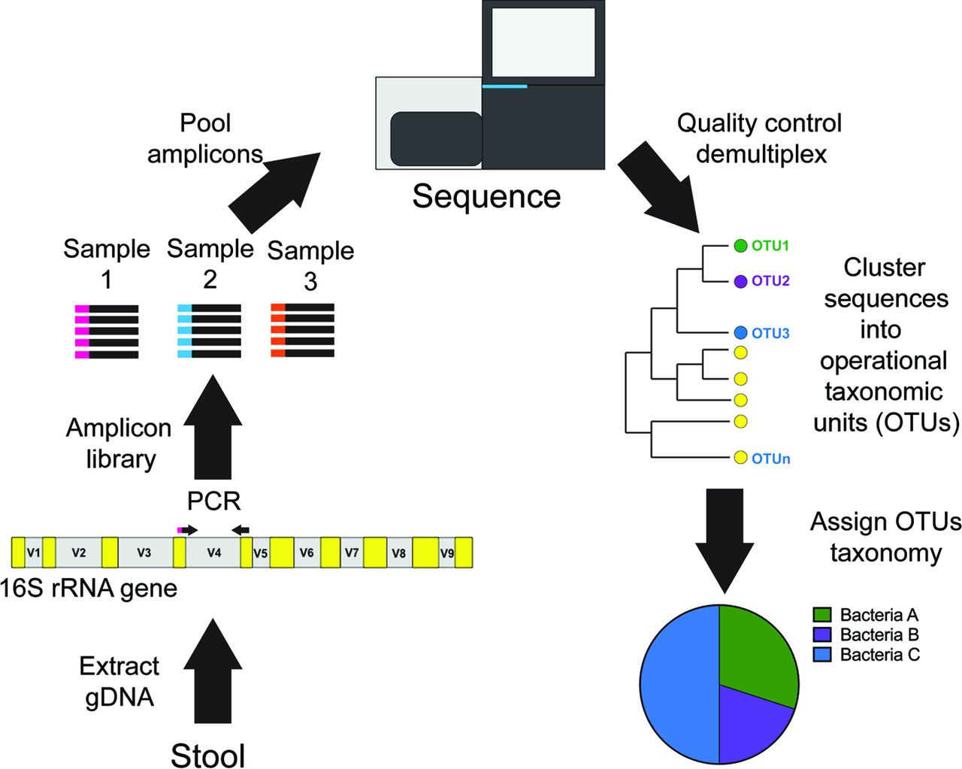
Sample analysis:
Introduction
Methods
Results and Discussion
Conclusions
Koh (2017)

Slide 20
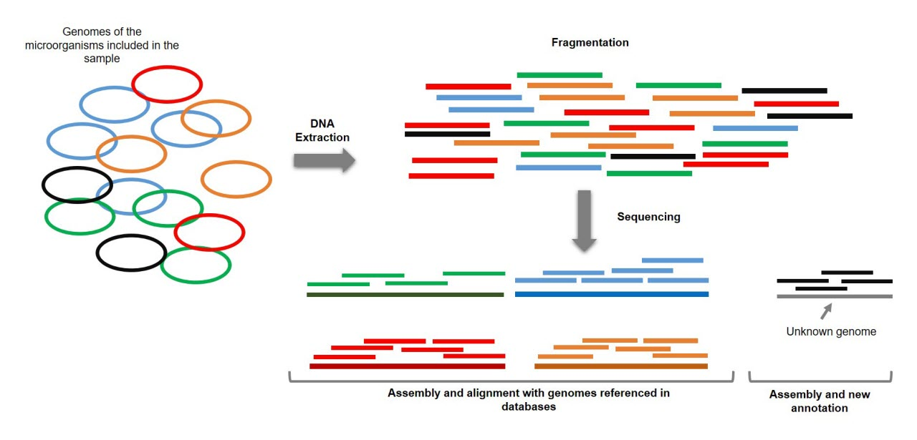
Sample analysis:
Introduction
Methods
Results and Discussion
Conclusions

Slide 21
Sample analysis:
Targeted PCR will be used to identify the positive sample(s) within each pool
If necessary, a partial sequencing will be performed to allow the phylogenetic analysis of the strain detected and track back its origin
Introduction
Methods
Results and Discussion
Conclusions

Slide 22
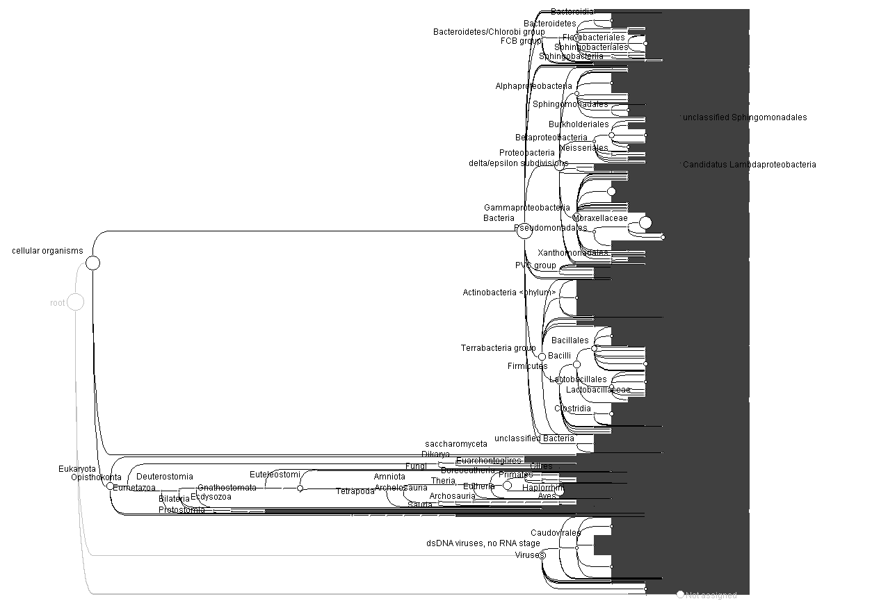
Introduction
Methods
Results and Discussion
Conclusions

Slide 23
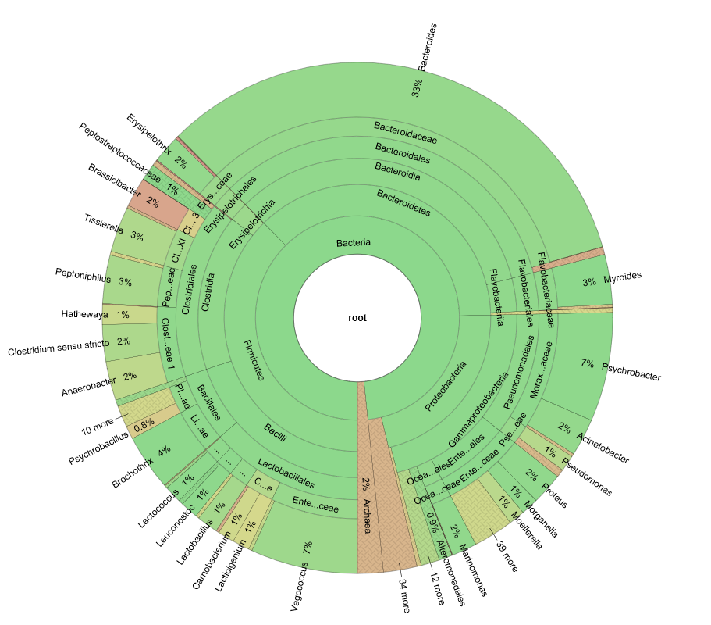
Introduction
Methods
Results and Discussion
Conclusions

Slide 24
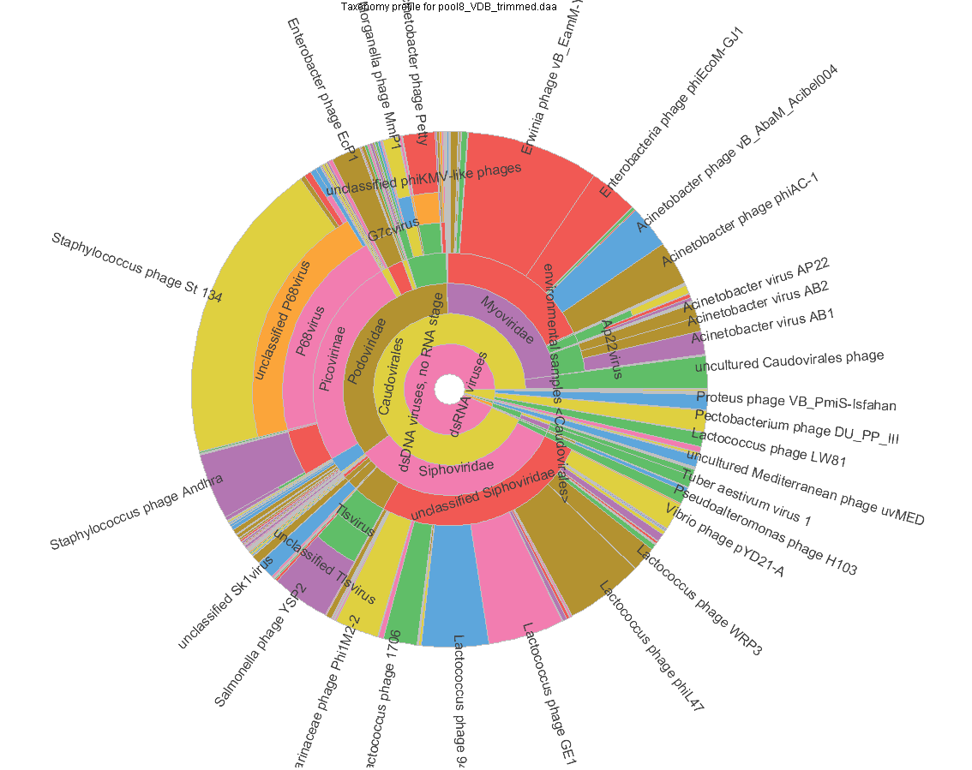
Introduction
Methods
Results and Discussion
Conclusions

Slide 25
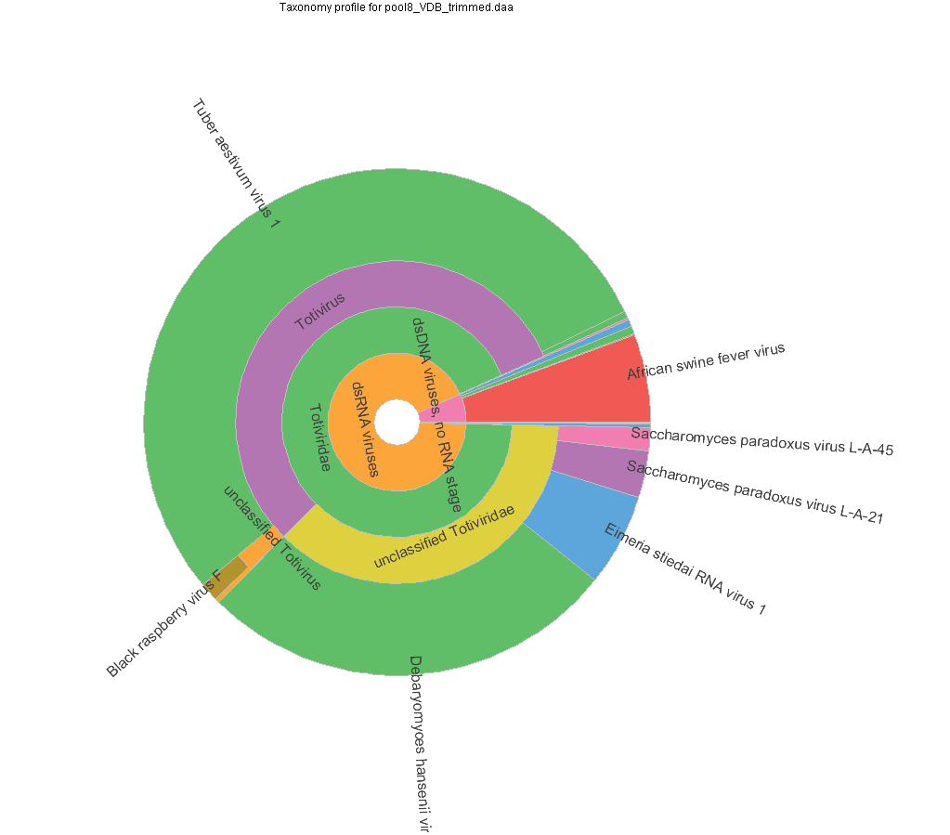
Introduction
Methods
Results and Discussion
Conclusions

Slide 26
Viruses:
Out of the 59 viruses listed, only African Swine Fever virus was detected (pool Nr 8)
Long storage period of leaking luggage before sampling (most viruses were lost in the meantime)
Targeted real time PCR allowed the identification of the ASFV positive sample
Introduction
Methods
Results and Discussion
Conclusions

Slide 27
Viruses:
Sample Nr L_070817_005; swine sample seized in a leaking luggage from Douala (Cameroon) on August 07, 2017
CT value: 28
Introduction
Methods
Results and Discussion
Conclusions

Slide 28
Introduction
Methods
Results and Discussion
Conclusions

Slide 29
Viruses:
Detection of relatively high amounts of ASFV DNA in this sample
This meat sample was determined as cooked by visual inspection
Although highly resistant in the environment, ASFV is inactivated at high t°
Isolation attempts are ongoing
Introduction
Methods
Results and Discussion
Conclusions

Slide 30
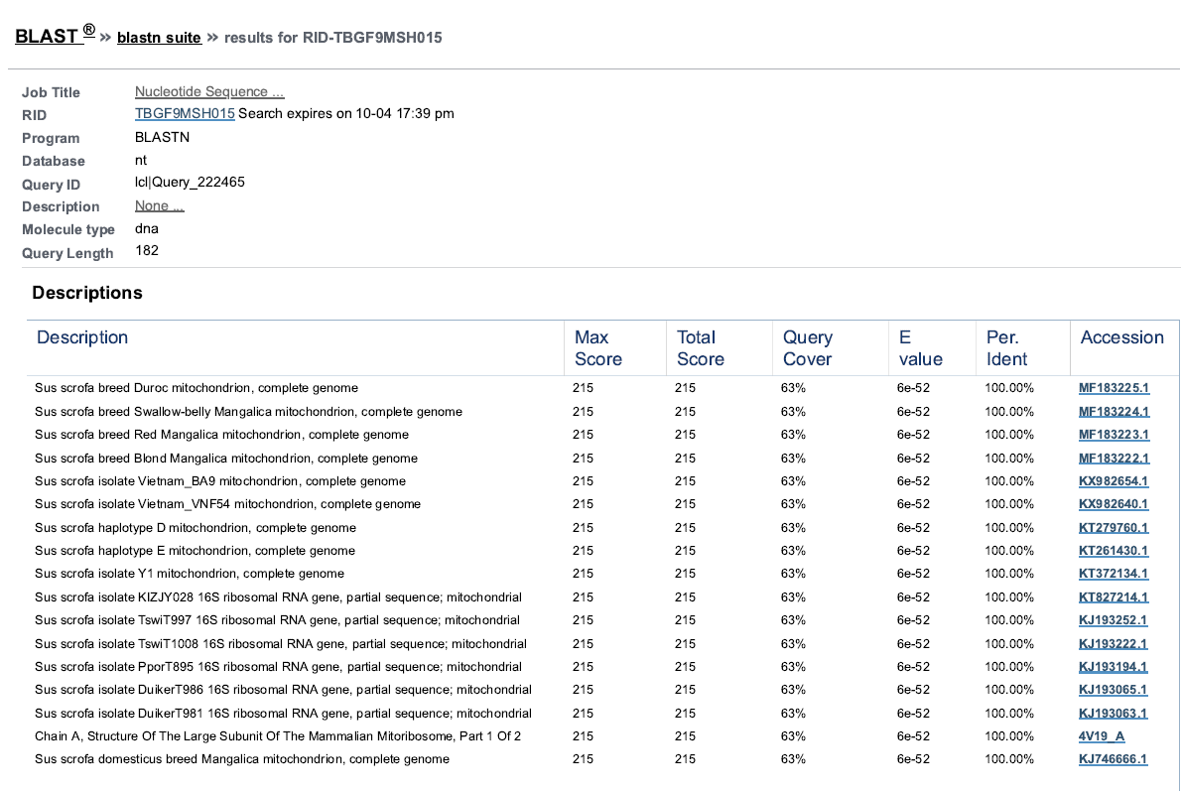
Partial sequencing of mitochondrial DNA
Introduction
Methods
Results and Discussion
Conclusions

Slide 31
BACTERIA (Genus level only - 16S metagenetics) | Zoonosis | Source | POOL 1 | POOL 2 | POOL 3 | POOL 4 | POOL 5 | POOL 6 | POOL 7 | POOL 8 | POOL 9 | POOL 10 | POOL 11 | POOL 12 | POOL 13
Anaplasma spp. | Yes | OIE |  | + |  | + |  | + | + |  |  | + | + | +
Bacillus anthracis | Yes | Both |  |  |  |  | + |  | + | + |  | + | + | + | +
Bartonella henselae | Yes | Cantlay |  |  |  |  |  |  | +
Brucella spp. | Yes | Cantlay |  | + |  |  |  |  |  |  | +
Burkholderia mallei |  | OIE
Campylobacter spp. | Yes | Cantlay
Chlamydia psittaci | Yes | OIE
Chlamydophila spp. | Yes | Cantlay
Coxiella burnetii | Yes | OIE |  | + | + |  |  |  | +
Dermatophilus congolensis | Yes | Cantlay |  | +
Edwardsiella tarda | Yes | Cantlay | + |  |  |  | + | + | + | + |  | + |  |  | +
Ehrlichia ruminantium |  | OIE
Erysipelothrix rhusiopathiae | Yes | Cantlay | + | + | + | + | + | + | + | + | + |  | + | + | +
Escherichia coli (VTEC) | Yes | Cantlay | + | + | + | + | + | + | + | + | + | + | + | + | +
Francisella tularensis | Yes | Cantlay
Leptospira spp. | Yes | Both
Mycobacterium avium ssp. Paratuberculosis | Yes | Cantlay
Mycobacterium tuberculosis complex | Yes | Cantlay
Mycoplasma agalactiae, M. capricolum ssp. Capricolum, M. mycoides subsp. Capri., M. putrefaciens |  | OIE
Mycoplasma capricolum subsp. Capripneumoniae |  | OIE
Mycoplasma gallisepticum |  | OIE
Mycoplasma mycoides subsp. Mycoides SC |  | OIE
Mycoplasma synoviae |  | OIE
Other Mycobacterium spp. |  | OIE
Pasteurella spp. | Yes | Cantlay |  |  |  |  |  |  |  |  |  | +
Salmonella spp. | Yes | Both | + |  |  |  |  |  | + | + | + | + | + | +
Shigella spp. | Yes | Cantlay | + | + | + | + | + | + | + | + | + | + | + | + | +
Streptococcus spp. | Yes | Cantlay | + |  | + | + |  | + |  | + | + | + | + | + | +
Taylorella equigenitalis |  | OIE
Yersinia spp. | Yes | Cantlay | + | + | + |  |  | + | + | + | + | + | + | + | +
Introduction
Methods
Results and Discussion
Conclusions

Slide 32
PARASITES | Zoonosis | Source | POOL 1 | POOL 2 | POOL 3 | POOL 4 | POOL 5 | POOL 6 | POOL 7 | POOL 8 | POOL 9 | POOL 10 | POOL 11 | POOL 12 | POOL 13
Ancylostoma spp | Yes | Cantlay
Anisakidae spp | Yes | Cantlay
Babesia spp | Yes | OIE |  | + |  | + |  | + | + | + | + | + | +
Balantidium coli | Yes | Both
Cryptosporidium spp | Yes | Cantlay
Echinococcus granulosus | Yes | OIE
Echinococcus multilocularis | Yes | OIE
Entamoeba histolytica | Yes | Both
Giardia spp | Yes | Both
Gnasthoma spp | Yes | Cantlay
Oesophagostomum spp | Yes | Cantlay
Pentastomidia spp | Yes | Cantlay
Sarcocystis spp | Yes | Cantlay
Spirometra spp | Yes | Cantlay
Strongyloides spp | Yes | Both
Taenia solium | Yes | OIE
Taenia spp | Yes | Cantlay
Theileria spp |  | OIE |  |  |  |  |  |  |  | +
Toxoplasma spp | Yes | Cantlay
Trichinella spp | Yes | Cantlay
Tritrichomonas fetus |  | OIE
Trypanosoma spp | Yes | OIE
Introduction
Methods
Results and Discussion
Conclusions

Slide 33
Bacteria:
Several potentially zoonotic bacterial genera have been identified:
Escherichia spp., Yersinia spp., Bacillus spp., Salmonella spp., Erysipelothrix spp.: risk of food-borne infection
Other bacteria, altough recognized zoonotic pathogens, are unlikely to be transmitted through meat consumption: Brucella spp., Coxiella spp.
Introduction
Methods
Results and Discussion
Conclusions

Slide 34
This pilot study confirms the risk of introduction of pathogens through the illegal importation of meat
Zoonotic or epizootic
Huge economic impact of the introduction of ASFV (estimated at > 700 millions euros in Belgium since September 2018; source: ProMed)
Introduction
Methods
Results and Discussion
Conclusions

Slide 35
The implementation of prevention and control measures could prevent and mitigate that risk
Should be implemented both at national and international scales
The analysis of fresh samples would give a more accurate overwiew of the pathogens actually carried in illegally imported meat
Introduction
Methods
Results and Discussion
Conclusions

Slide 36
Questions?

