Slide 1
Approach taken in the setting-up of positive lists of reptiles at regional level (Flanders)
Dr. Tom Hellebuyck (PhD, DVM, Dipl EZCM)
Departement Pathology, Bacteriology and Avian disases
Division of Poultry, Exotic Companion Animals, Wildlife and Experimental Animals
Faculty of VeteriNary Medicine, Ghent University

Slide 2
History
Law on the protection and the welfare of animals1986
Prior attempts/initiatives:
2004 (Flanders)
2005 (Wallony)
Two independent proposals assessed by team of experts (N = 161)
Positive advise Zoo Commission
No consensus: N = 69 vs. 1226
2015: Policy report, regulation of the keeping of reptiles
proposal list Wallony (Conseil Wallon du Bien-être Animal)
as a basis (Flemish Board for Animal Welfare)

Slide 3
Context/Objective
Reptiles are becoming more and more popular as pets?
Animal welfare issues in relation to conventional pets?
Wildcaught animals
…
Decennia of experience
Captive breeding of challenging species:
> ‘conservation’
Safeguard continuity of positive evolution

Slide 4
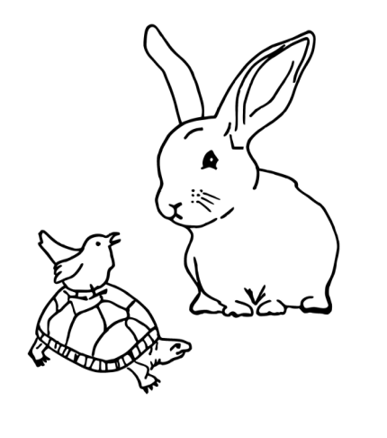
Working Group

Slide 5
WORKFLOW
Objectives & procedure
Propose criteria
(cf. List Wallony, mammals)
Appoint coordinators
subworking groups
Sauria, Serpentes, Chelonia
Criteria approved +
captive bred endemic species
availability invasive species
Evaluate proposed lists
Preliminary outline:
Procedure periodic revision list
Procedure application exception
Approve proposal list(s)
Dynamic concept:
Procedure periodic revision list (q2 yrs)
Procedure application exception
January 2018
April 2018
September 2018
Formulate Advise
To
Board Animal Welfare (Nov 2018)

Slide 6
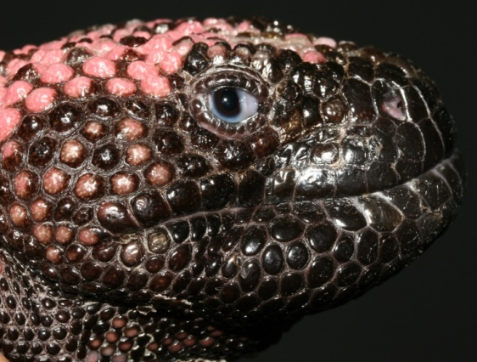
Criteria
No prior knowledge/experience
Captive bred individuals
Routinely available/bred
1. Feasibility captive management
3. Availability of data
2. No danger to humans
1.1. Housing
1.2. Natural habitat
1.3. Nutritional demands
1.4. Manageable size
1.5. ‘Species sensitivity’
Objectivity
Scientific argumentation
Trends

Slide 7
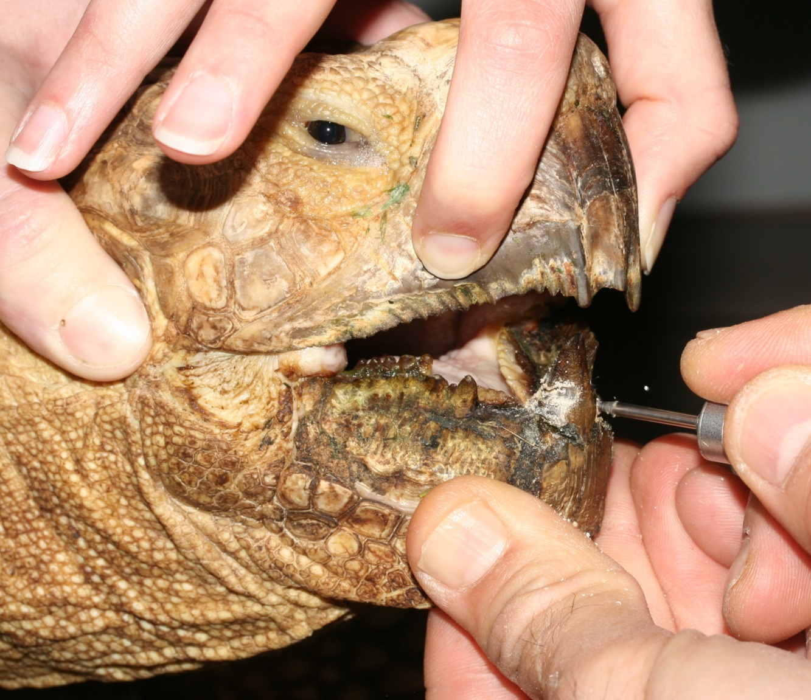
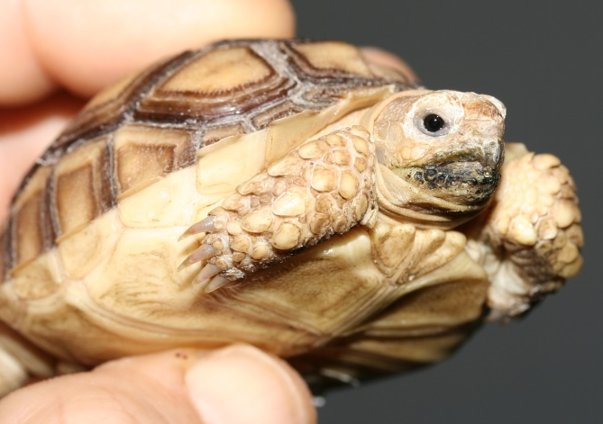
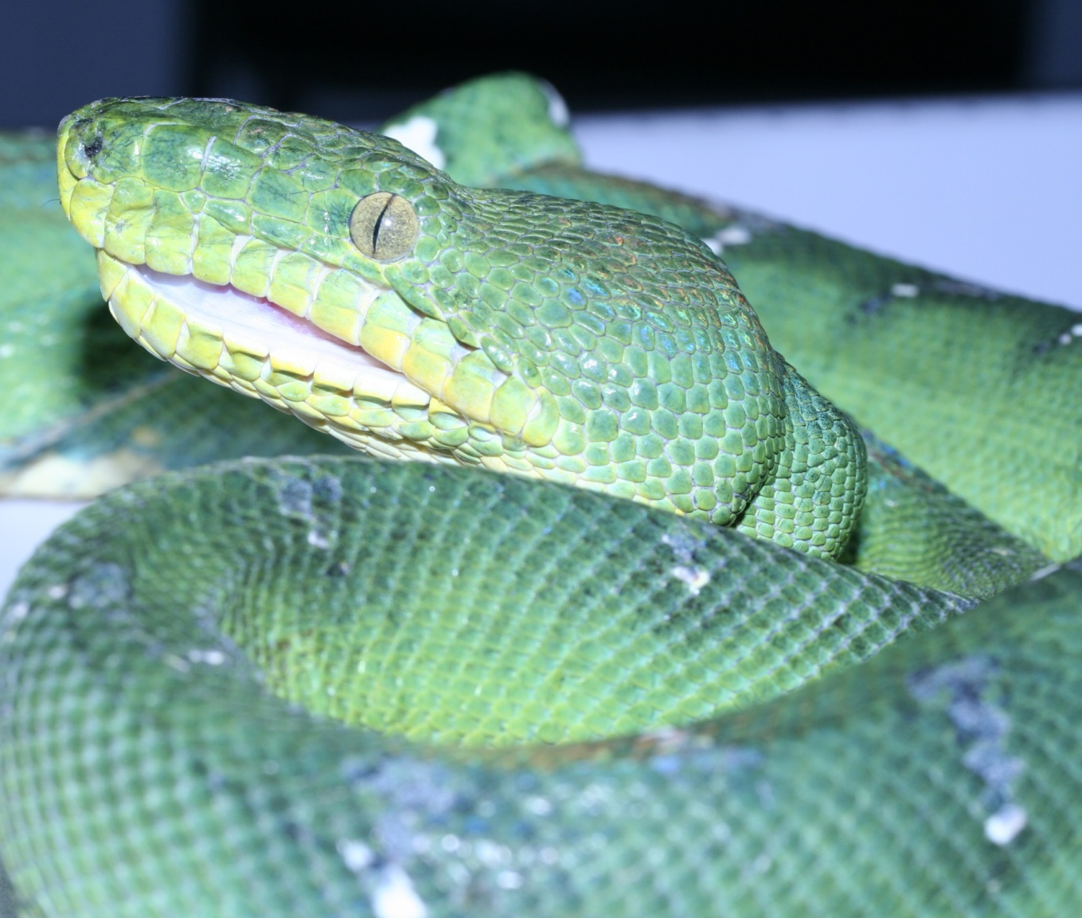
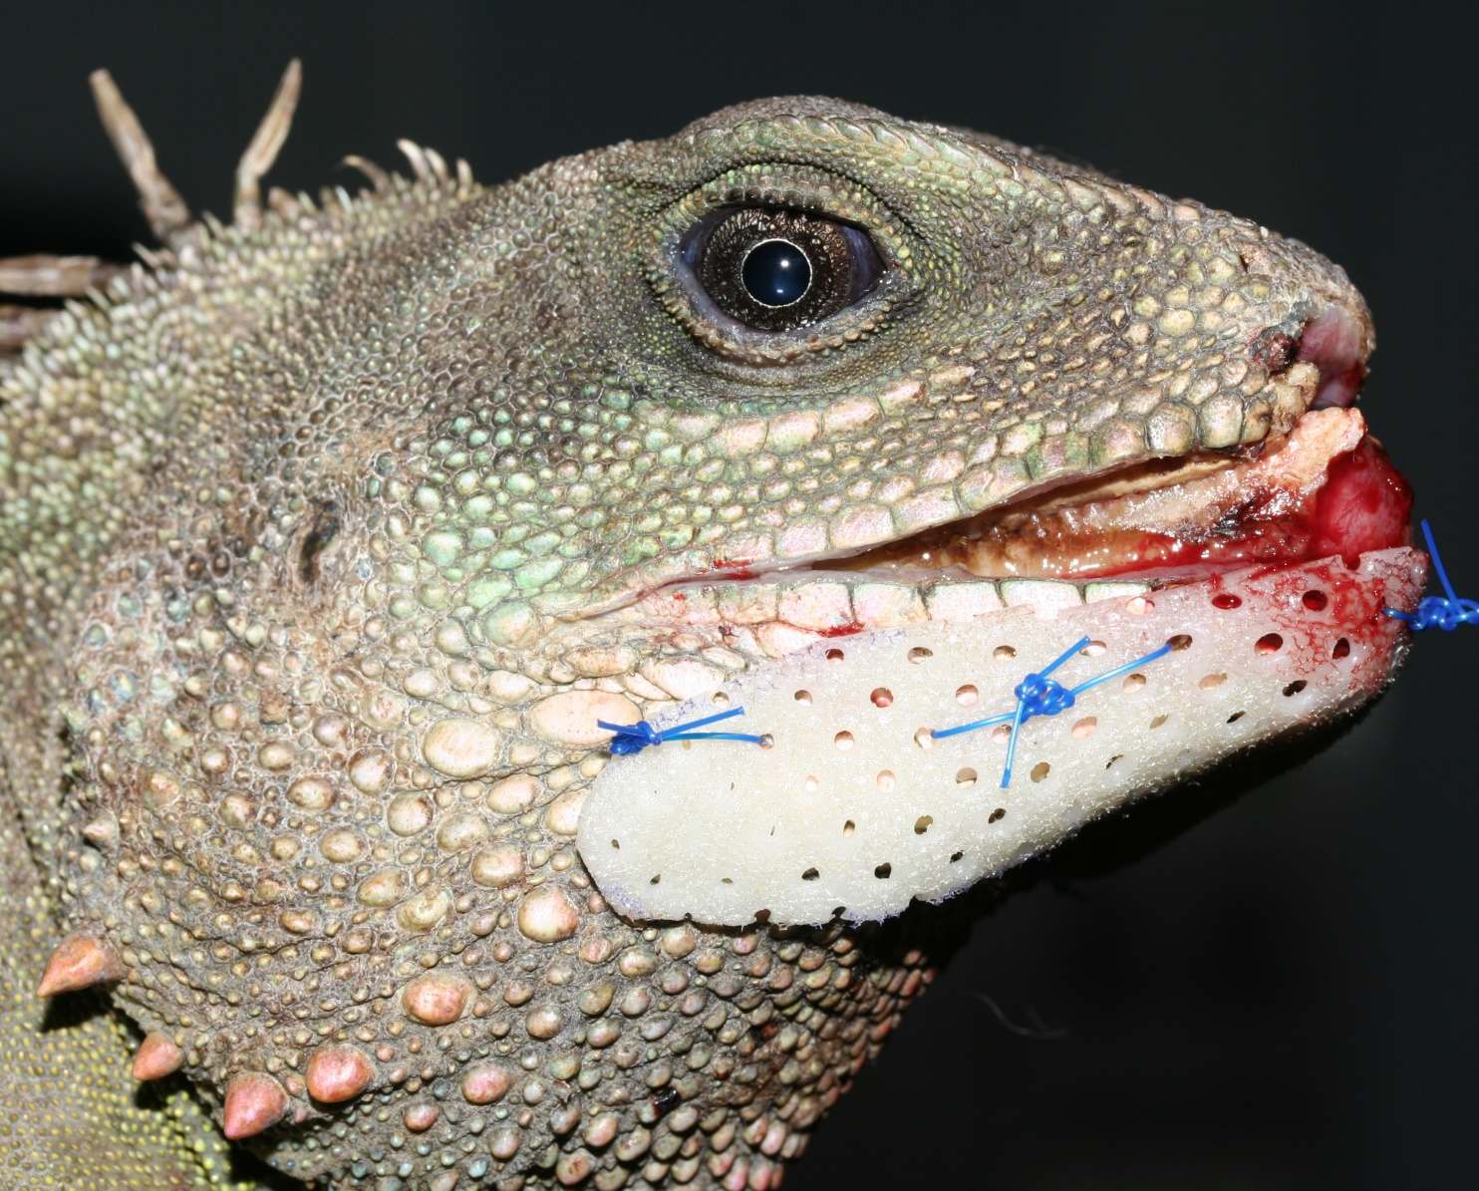

Slide 8
Towards a ‘Dynamic list’
No ideal list (11.000 extant species): dynamic aspect
Number of spp. that meet primary criterium… >>>>
Current & future trends (popularity spp.)
Animal welfare issues
Invasive spp.
Stakeholders
Periodic revision: exclude/include species
Applicate for exception (law 1986):
Zoo Commission & Working Group

Slide 9
The result:Positive list Reptiles Flanders
Advise
Sauria Chelonia Serpentes
TOTAL 422
Vision
List of species
Transition period 6 months
Dynamic list: procedures
Wallony: 232 species
https://www.huisdierinfo.be/welke-reptielen-mag-je-houden

Slide 10
WORKFLOW
Regularization
Board for Animal Welfare:
Evaluation advise
Unanimous approval
6 MOO
BVR
Campaign
Council of State
Implementation
November 28 2018
March 13 2019
March 22 2019
October 1st 2019

Slide 11
Current situation
N° online registrations
N° applications for exception
Working group meeting
Zoo Commission
October 2019

Slide 12
Conclusion & discussion
Ultimate goal: instrument to improve welfare captive reptiles
Legal basis: authorized officials - evaluate and control
Trade: control, traceability, transparency
Impact on trade > wild caught animals
Impact hobby? - expertise/input/transparency
Most common/popular spp. most susceptible to welfare issues?
Evaluation of impact/effects? (e.g. data from shelters)
Impact on other regulations & vice versa
Application and effect dynamic concept

Slide 13
Thank you for listening
Tom.Hellebuyck@UGent

