Slide 1

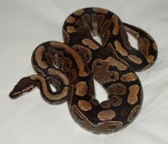
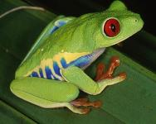
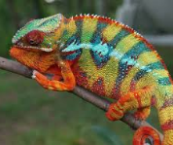
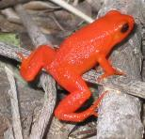
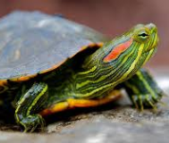
Dead or Alive: Towards a Sustainable Wildlife Trade
3-4 December 2019
Threats to reptiles and amphibians posed by live trade: reconciling conservation, welfare and sustainable use
Richard A. Griffiths R.A.Griffiths@kent.ac.uk
Notes:
V1.0
To change the footer on every slide:
1. On the menu go to Insert > Header and Footer…
2. Select the Footer checkbox and enter the footer text in the accompanying text box
3. Click “Apply to All”

Slide 2
Benefits of the trade in reptiles and amphibians | Risks of the trade in reptiles and amphibians
Positive effects on human health and wellbeing | Negative effects on human health and wellbeing
Keeping animals is educational | Keeping animals sends inappropriate educational messages
Sustainable use benefits conservation | Collection is detrimental to conservation
Environmental conditions for captive animals easy to reproduce | Difficult to reproduce stress-free conditions for many species
Captive bred animals relieve pressure on wild populations | Captive bred animals stimulate trade for wild animals
Trade results in benefits for local communities | Trade results in illegal activity and economic benefits that are unequally shared
Study of captive animals can produce important research | Trade spreads invasive species and disease

Slide 3
Benefits of the trade in reptiles and amphibians | Risks of the trade in reptiles and amphibians
Positive effects on human health and wellbeing | Negative effects on human health and wellbeing
Keeping animals is educational | Keeping animals sends inappropriate educational messages
Sustainable use benefits conservation | Collection is detrimental to conservation
Environmental conditions for captive animals easy to reproduce | Difficult to reproduce stress-free conditions for many species
Captive bred animals relieve pressure on wild populations | Captive bred animals stimulate trade for wild animals
Trade results in benefits for local communities | Trade results in illegal activity and economic benefits that are unequally shared
Study of captive animals can produce important research | Trade spreads invasive species and disease

Slide 4

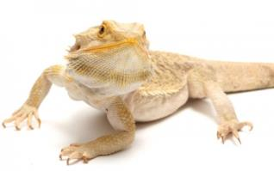

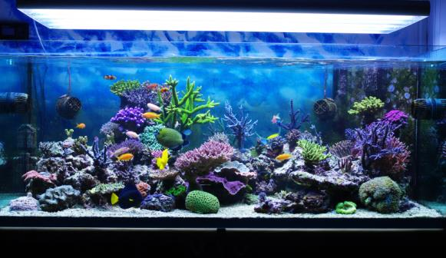
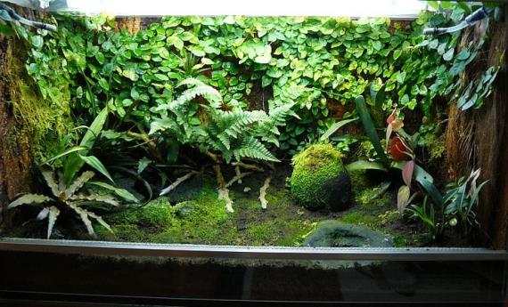
Human health and wellbeing?

Slide 5
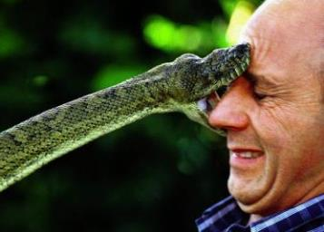

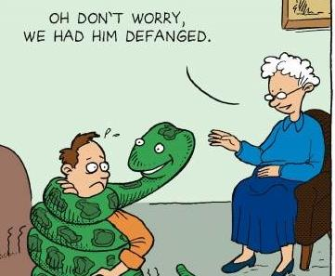
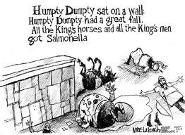
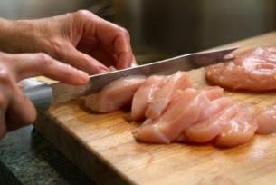
Human health and wellbeing?

Slide 6
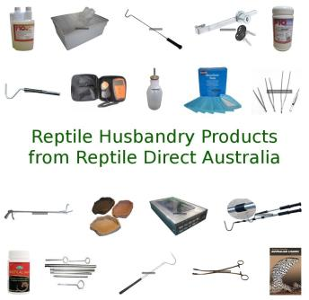
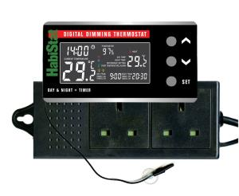
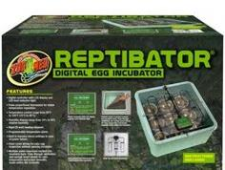
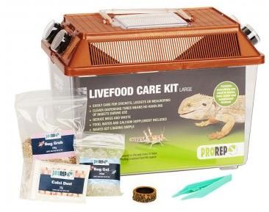
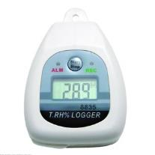
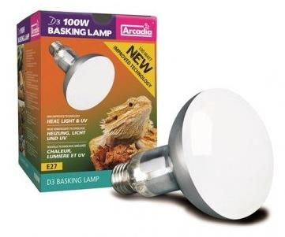
Improving technology improves welfare but drives trade dynamics

Slide 7
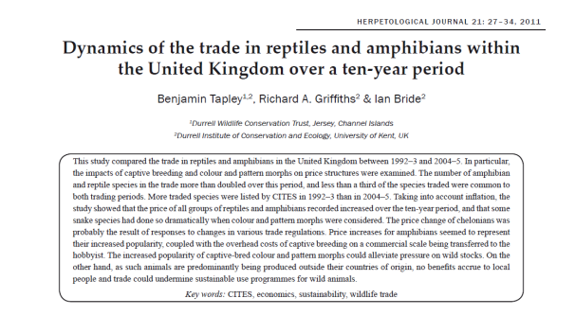

Dynamics of the trade: changes in supply, demand and price
Number of species in the trade doubled between 1993 and 2005
Only about a third were common to both periods
General increase in price, but wide variation between species
Unusual colour morphs increase in price by <1000%

Slide 8
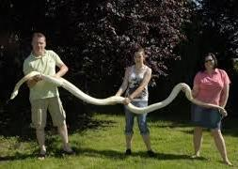
Dynamics of the trade: changes in supply, demand and price
Number of species in the trade doubled between 1993 and 2005
Only about a third were common to both periods
General increase in price, but wide variation between species
Unusual colour morphs increase in price by <1000%

Slide 9
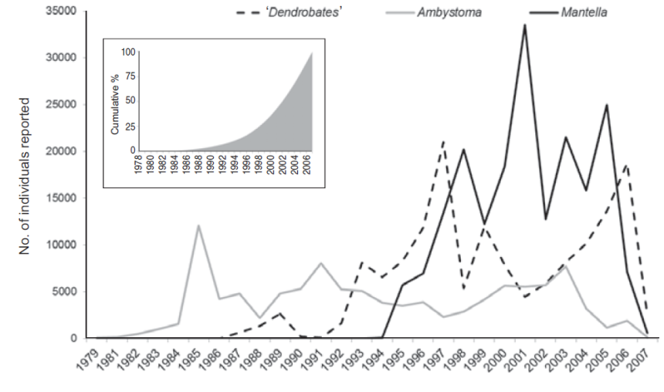



Trade in top three CITES listed amphibians:
1979-2007
Carpenter et al. Oryx 48: 568-574 (2014)

Slide 10
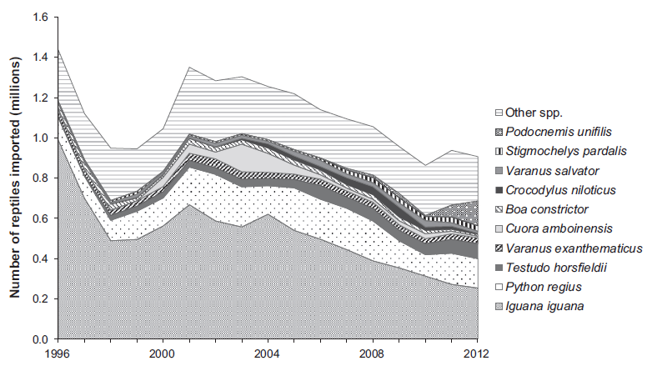
Trade in top ten CITES listed reptiles:
1996-2012
Robinson et al. Biol Cons 184: 42-50 (2015)

Slide 11

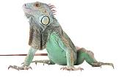
Trade in top ten CITES listed reptiles:
1996-2012
decrease in wild caught
increase in ranched/captive bred
Robinson et al. Biol Cons 184: 42-50 (2015)

Slide 12
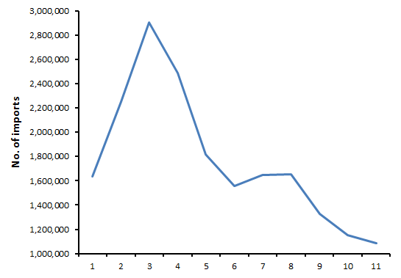
Imports of non-CITES listed species into the EU:
2005-2015
2005 2006 2007 2008 2009 2010 2011 2012 2013 2014 2015
Source: EU statistics

Slide 13
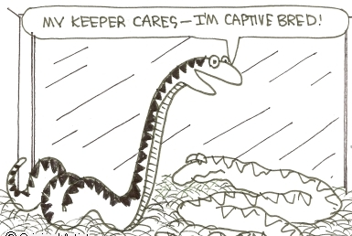
Captive-bred = ‘good’, wild-caught = ‘bad’?

Slide 14
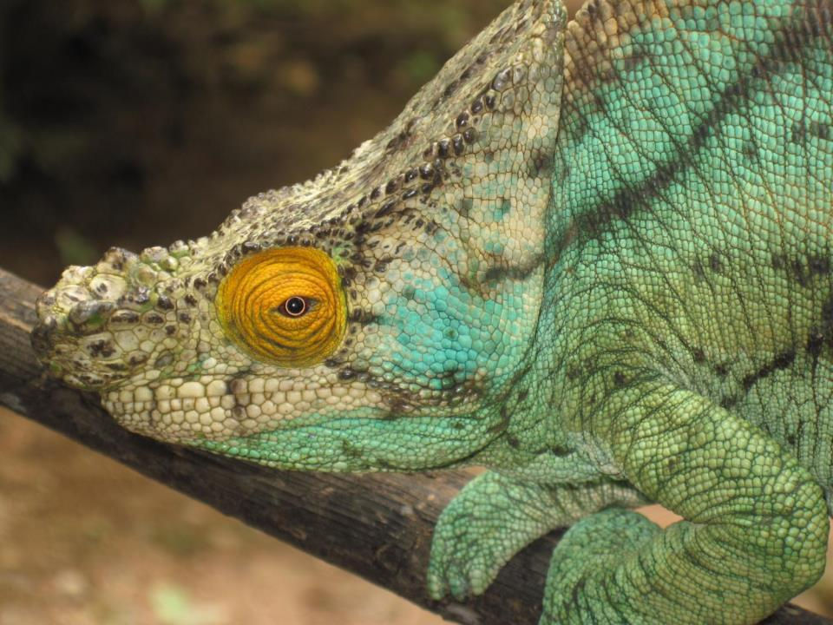
What is sustainable use?
Convention on Biological Diversity:
“Sustainable wildlife management (SWM) is the sound management of wildlife species to sustain their populations and habitat over time, taking into account the socioeconomic needs of human populations. This requires that all land-users within the wildlife habitat are aware of and consider the effects of their activities on the wildlife resources and habitat, and on other user groups.”

Slide 15
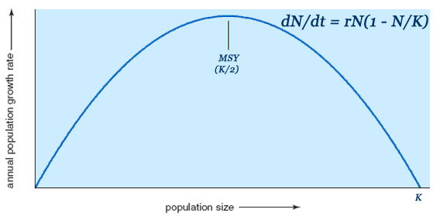
Calculating Maximum Sustainable Yield (MSY)

Slide 16
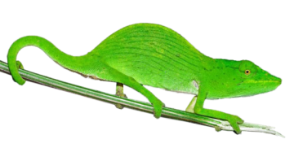
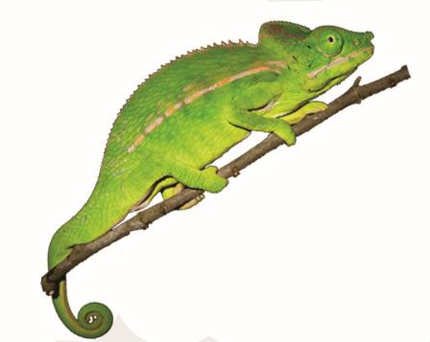
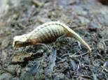
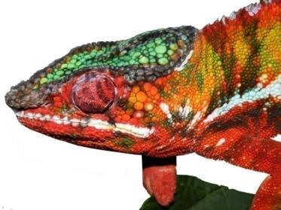
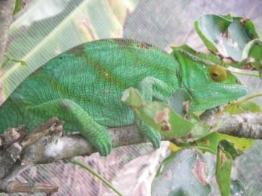
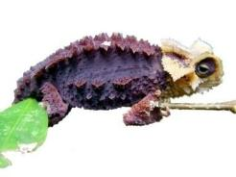
Chameleons of Madagascar
Brookesia/
Palleon
32 species
Calumma
38 species
Furcifer
24 species
Notes:
In Madagascar, we have seventy six described chameleon species: twenty seven dwarf chameleon Brookesia, thirty one Calumma species, and eighteen Furcifer.

Slide 17
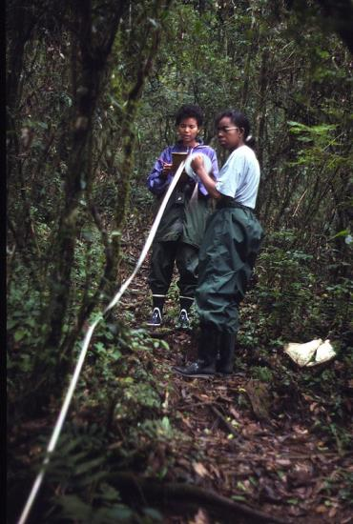
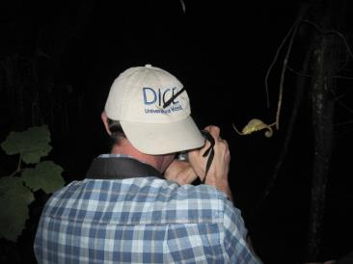
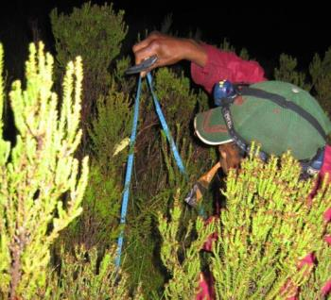
Estimating chameleon population densities

Slide 18
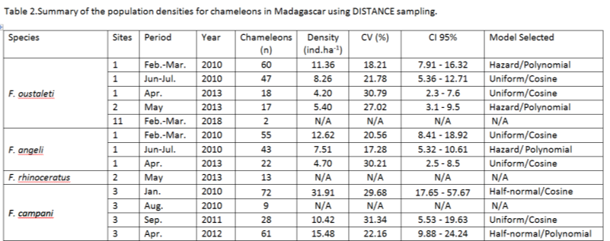
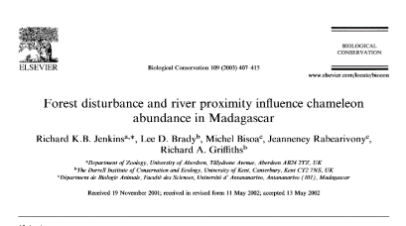
Estimating chameleon population densities

Slide 19
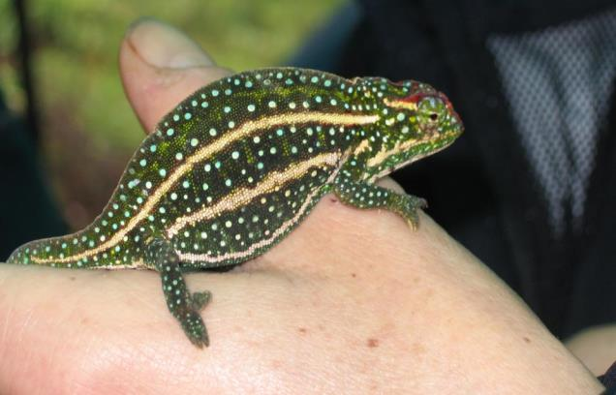
Malagasy chameleon export quotas
New quota of 250
in 2012!
Furcifer campani

Slide 20
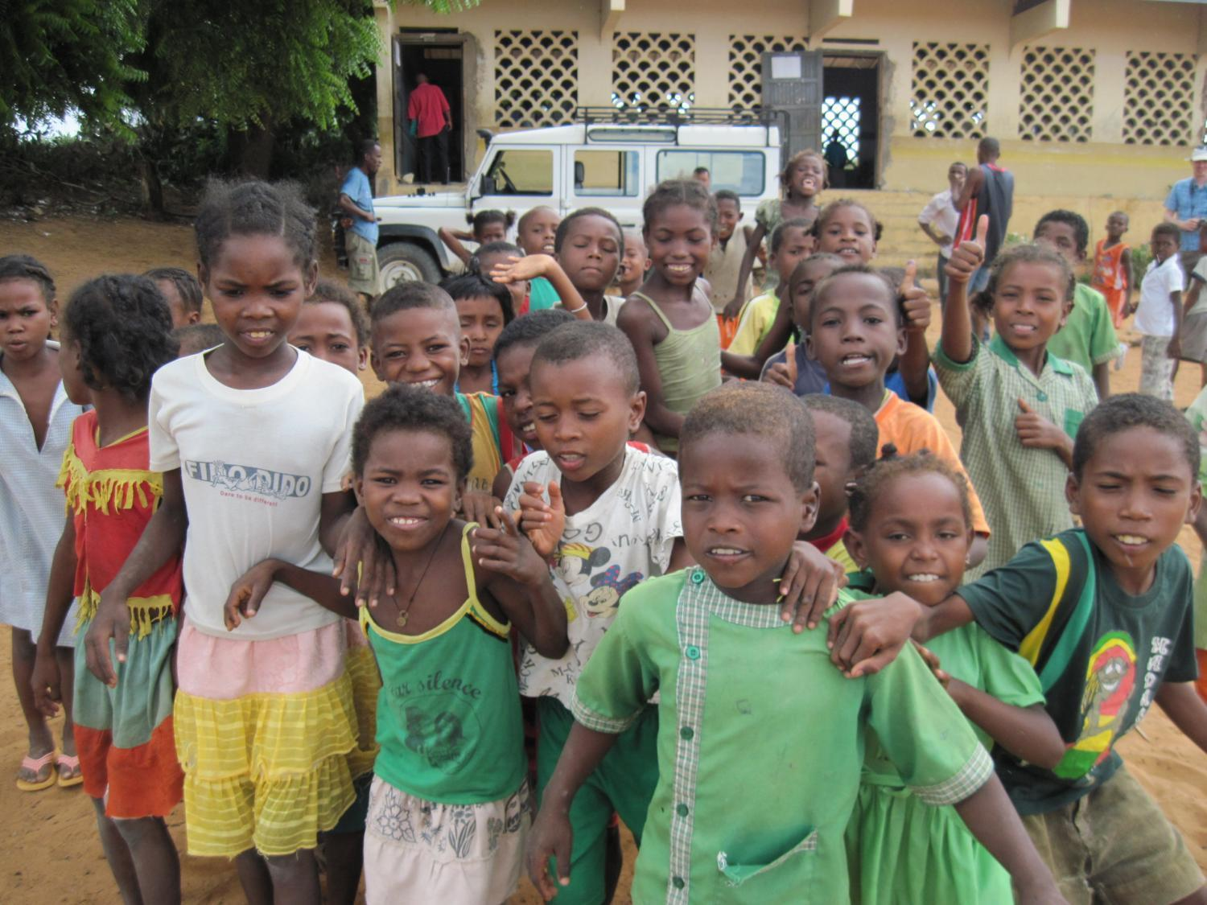
Do local communities benefit?

Slide 21
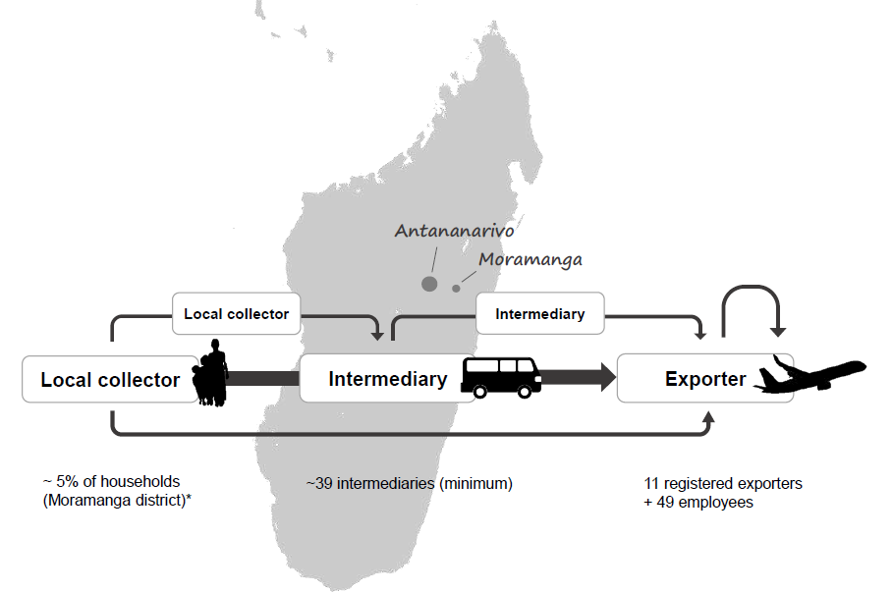
The collection-supply chain in Madagascar
From: Robinson et al. Biol. Cons. 226:144-152 (2018)

Slide 22
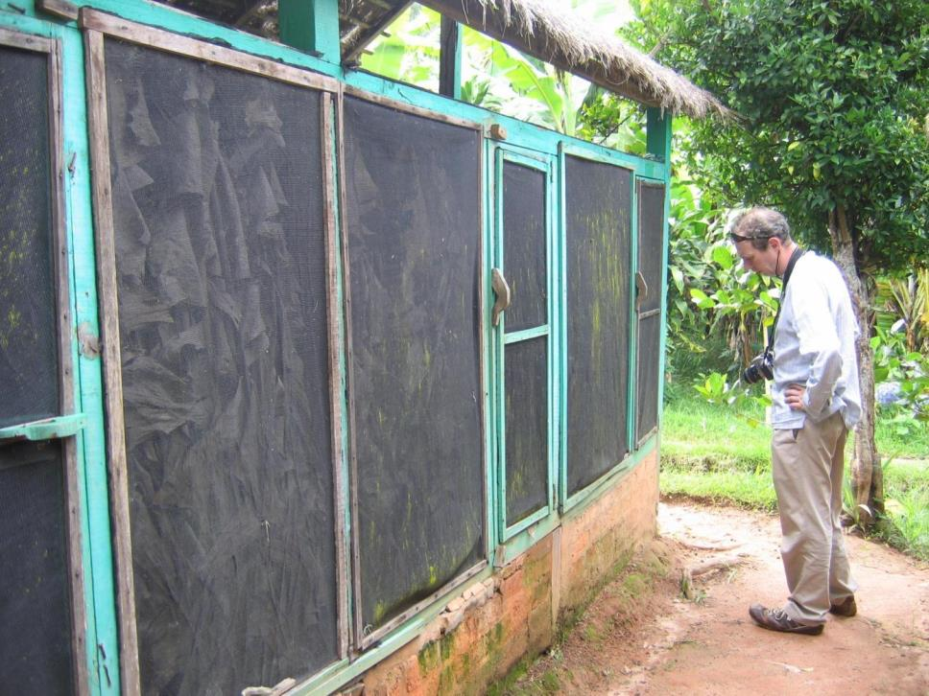

Slide 23
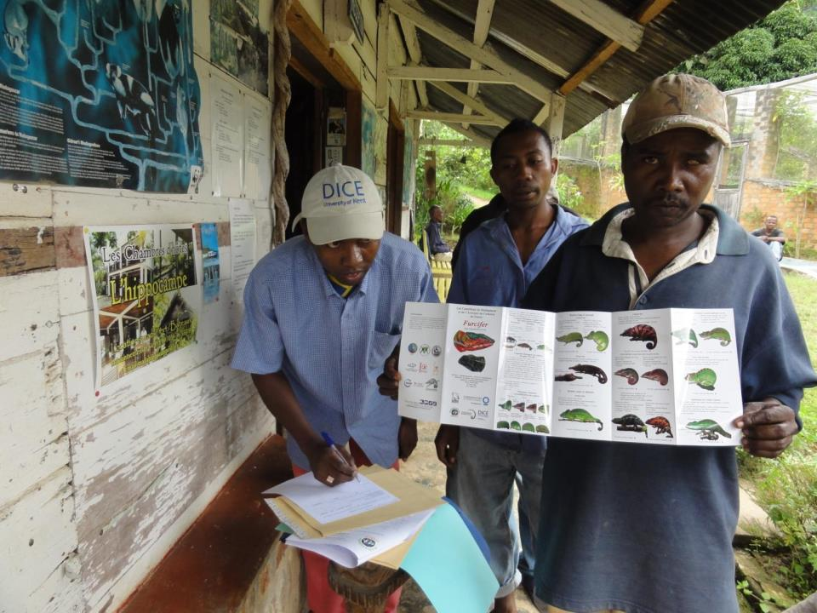

Slide 24
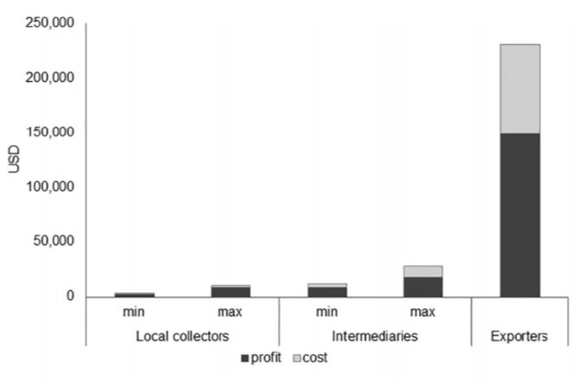
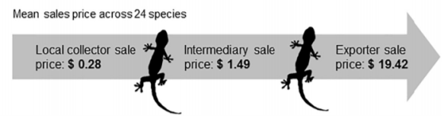
Profitability along the supply chain in Madagascar
5% of households collect amphibian and reptiles for the trade
Generates c. $100 per season
Part-time, risky and financially unreliable income
Low incentives for stewardship of species and habitats
From: Robinson et al. Biol. Cons. 226:144-152 (2018)

Slide 25
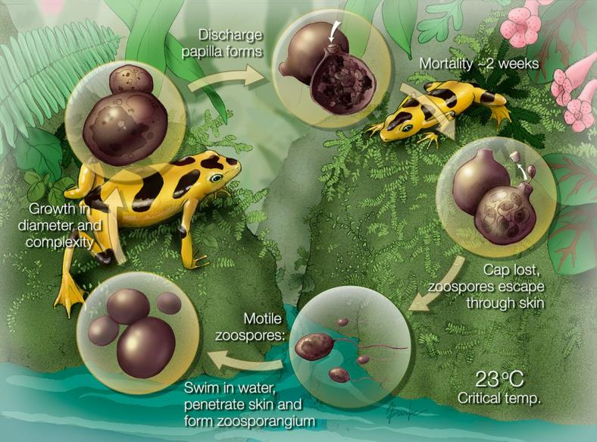
What is the threat posed by disease?

Slide 26
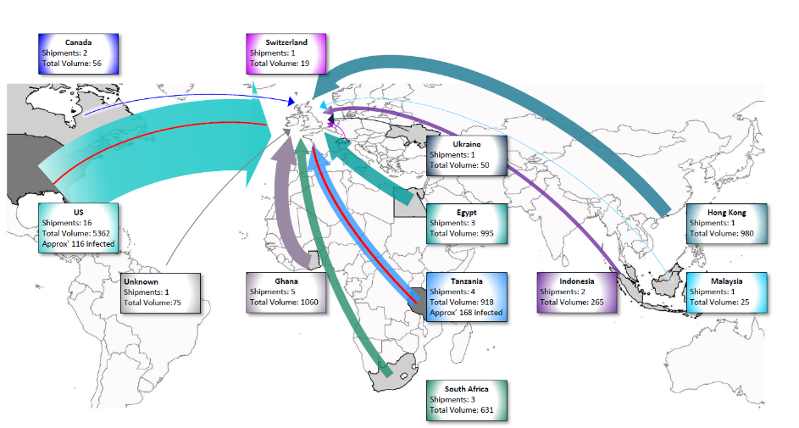
Routes and volumes of amphibian imports into the UK (LHR) – 2009-2012
12 countries involved (Bd from 2)
73% from 3 countries
19-1000 animals per consignment
25% re-exported
Wombwell, E. PhD thesis, Univ of Kent (2014).

Slide 27

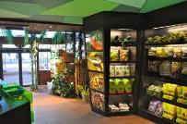
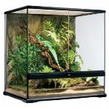

Transmission of Bd along the trade chain
Bd present in:
12% of consignments
3.6% of amphibians
Bd present in:
17 % of shops
Bd present in:
6% of vivaria
Bd present in:
6% of amphibians
Wombwell, E. PhD thesis, Univ of Kent (2014).

Slide 28
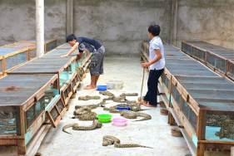


Tackling the problems
Supply
Demand
impact on wild populations
socioeconomic drivers
livelihoods
legislation
enforcement
education
biosecurity
invasives/disease
legislation
enforcement

Slide 29

The effect of bans
Rivalan et al. Can bans stimulate wildlife trade? Nature 447: 529-530 (2007).

Slide 30

Conclusions
Shifting demand and supply
Sustainable harvesting is difficult to demonstrate
Local communities may benefit little from the trade
Disease may be a growing issue
Bans unlikely to work
Work with all stakeholders along the demand – supply chain!

Slide 31
















Heathrow
Animal Reception
Centre
Calumma Ecological Services

